Slide 1
Chapter 3
The Molecules of Life

Slide 2
Organic Compounds유기화합물
A cell is mostly water.
The rest of the cell consists mainly of carbon-based molecules.
Carbon forms large, complex, and diverse molecules necessary for life’s functions.
Organic compounds are carbon-based molecules.
Notes:
2
Student Misconceptions and Concerns
1. General biology students might not have previously taken a chemistry course. The concept of molecular building blocks that cannot be seen can be abstract and difficult to comprehend for such students. Concrete examples from our diets and good images will increase comprehension.
2. Students might need to be reminded about the levels of biological organization. The relationship between atoms, monomers, and polymers can be confusing. Consider noting these relationships somewhere in the classroom (such as on the board) where students can quickly glance for reassurance.
Teaching Tips
1. One of the great advantages of carbon is its ability to form up to four bonds, permitting the assembly of diverse components and branching configurations. Challenge your students to find another element that might also permit this sort of adaptability. (Like carbon, silicon has four electrons in its outer shell.)
2. Toothpicks and gumdrops (or any other pliable small candy) permit the quick construction of chemical models. Different candy colors can represent certain atoms. The model of the methane molecule in Figure 3.2 can thus easily be demonstrated (and consumed!).
3. A drill with interchangeable drill bits is a nice analogy to carbon skeletons with different functional groups. The analogy supports the role of different functions with different structures.
4. The author notes that a polymer is a like a pearl necklace made of many pearl “monomers.”
5. Train cars linking together to form a train is another nice analogy to monomers linking to form polymers. Consider adding that as the train cars are joined, a puff of steam appears—thus, the reference to water production and a dehydration reaction when linking molecular monomers.
Active Lecture Tips
1. See the Activity Reviewing Macromolecules on the Instructor Exchange. Visit the Instructor Exchange in the MasteringBiology instructor resource area for a description of this activity.

Slide 3
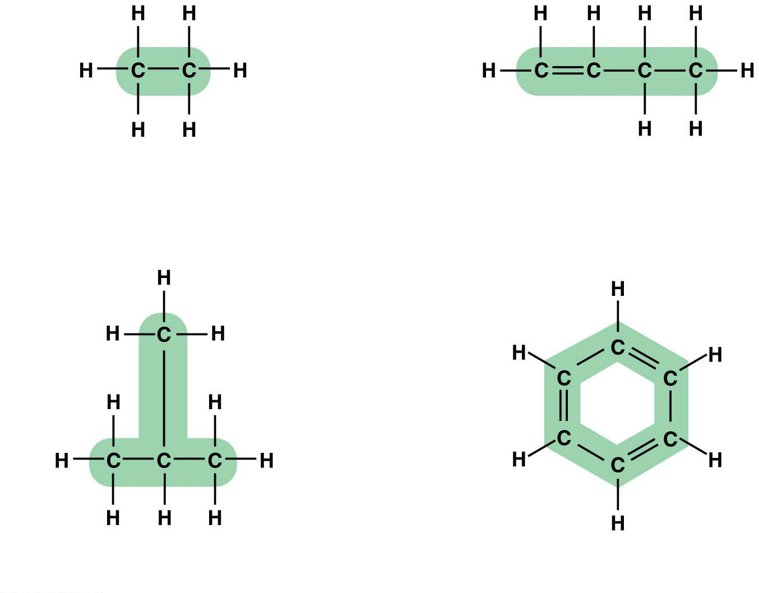
Carbon Chemistry
Carbon is a versatile molecule.
Carbon can share electrons with other atoms in four covalent bonds.
Because carbon can use one or more of its bonds to attach to other carbon atoms, it is possible to construct an endless diversity of carbon skeletons varying in
size and
branching pattern.
Carbon skeletons vary in length
Carbon skeletons may
have double bonds,
which can vary in location
Carbon skeletons may be
unbranched or branched
Carbon skeletons may
be arranged in rings
Notes:
3
Student Misconceptions and Concerns
1. General biology students might not have previously taken a chemistry course. The concept of molecular building blocks that cannot be seen can be abstract and difficult to comprehend for such students. Concrete examples from our diets and good images will increase comprehension.
2. Students might need to be reminded about the levels of biological organization. The relationship between atoms, monomers, and polymers can be confusing. Consider noting these relationships somewhere in the classroom (such as on the board) where students can quickly glance for reassurance.
Teaching Tips
1. One of the great advantages of carbon is its ability to form up to four bonds, permitting the assembly of diverse components and branching configurations. Challenge your students to find another element that might also permit this sort of adaptability. (Like carbon, silicon has four electrons in its outer shell.)
2. Toothpicks and gumdrops (or any other pliable small candy) permit the quick construction of chemical models. Different candy colors can represent certain atoms. The model of the methane molecule in Figure 3.2 can thus easily be demonstrated (and consumed!).
3. A drill with interchangeable drill bits is a nice analogy to carbon skeletons with different functional groups. The analogy supports the role of different functions with different structures.
4. The author notes that a polymer is a like a pearl necklace made of many pearl “monomers.”
5. Train cars linking together to form a train is another nice analogy to monomers linking to form polymers. Consider adding that as the train cars are joined, a puff of steam appears—thus, the reference to water production and a dehydration reaction when linking molecular monomers.
Active Lecture Tips
1. See the Activity Reviewing Macromolecules on the Instructor Exchange. Visit the Instructor Exchange in the MasteringBiology instructor resource area for a description of this activity.

Slide 4
The carbon atoms of organic compounds can also bond with other elements, most commonly
hydrogen, oxygen, and nitrogen.
The unique properties of an organic compound depend on
its carbon skeleton and
the atoms attached to the skeleton.
In an organic compound, the groups of atoms directly involved in chemical reactions are called functional groups작용기.
Each functional group plays a particular role during chemical reactions.
Many biological molecules have two or more functional groups.
Notes:
4
Student Misconceptions and Concerns
1. General biology students might not have previously taken a chemistry course. The concept of molecular building blocks that cannot be seen can be abstract and difficult to comprehend for such students. Concrete examples from our diets and good images will increase comprehension.
2. Students might need to be reminded about the levels of biological organization. The relationship between atoms, monomers, and polymers can be confusing. Consider noting these relationships somewhere in the classroom (such as on the board) where students can quickly glance for reassurance.
Teaching Tips
1. One of the great advantages of carbon is its ability to form up to four bonds, permitting the assembly of diverse components and branching configurations. Challenge your students to find another element that might also permit this sort of adaptability. (Like carbon, silicon has four electrons in its outer shell.)
2. Toothpicks and gumdrops (or any other pliable small candy) permit the quick construction of chemical models. Different candy colors can represent certain atoms. The model of the methane molecule in Figure 3.2 can thus easily be demonstrated (and consumed!).
3. A drill with interchangeable drill bits is a nice analogy to carbon skeletons with different functional groups. The analogy supports the role of different functions with different structures.
4. The author notes that a polymer is a like a pearl necklace made of many pearl “monomers.”
5. Train cars linking together to form a train is another nice analogy to monomers linking to form polymers. Consider adding that as the train cars are joined, a puff of steam appears—thus, the reference to water production and a dehydration reaction when linking molecular monomers.
Active Lecture Tips
1. See the Activity Reviewing Macromolecules on the Instructor Exchange. Visit the Instructor Exchange in the MasteringBiology instructor resource area for a description of this activity.

Slide 5
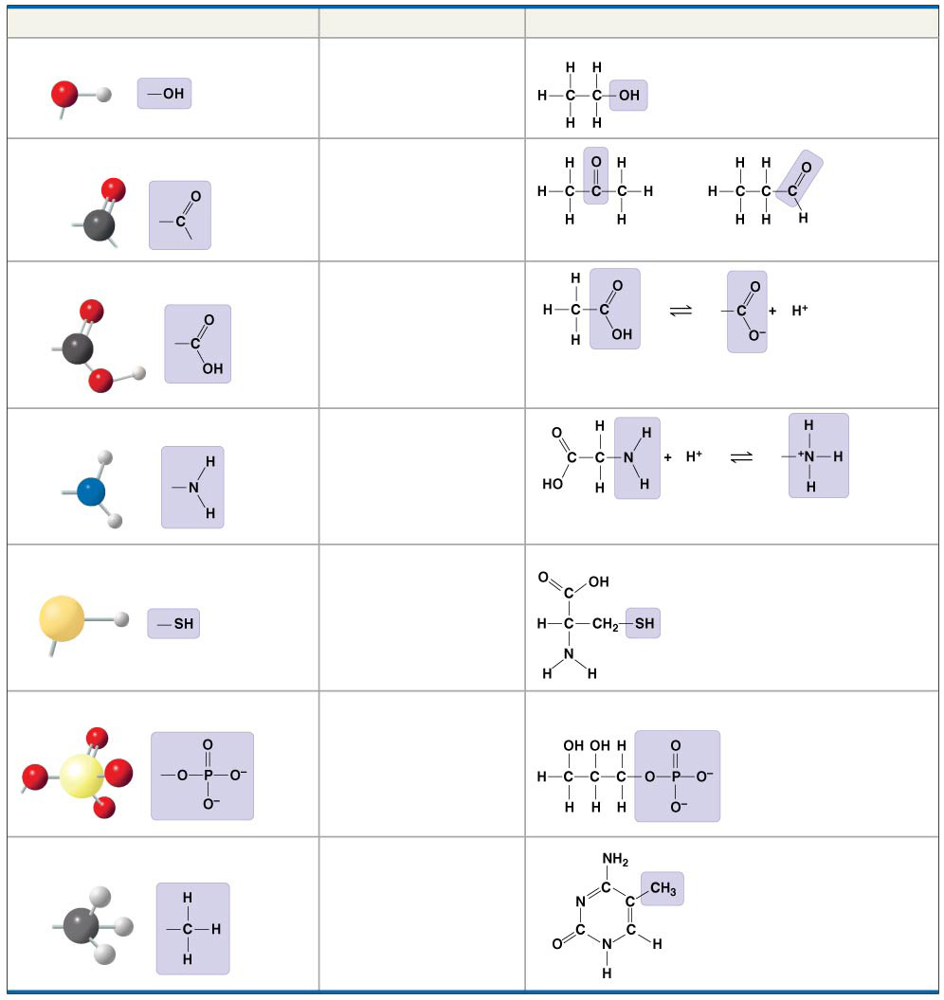
Chemical Group
Compound Name
Examples
Hydroxyl group (—OH)
Alcohol
Ethanol
Carbonyl group
—
Ketone
Aldehyde
( C＝O)
—
Acetone
Propanal
Carboxyl group (—COOH)
Carboxylic acid, or
organic acid
Acetic acid
Amino group (—NH₂)
Amine
Glycine
Sulfhydryl group (—SH)
Thiol
Cysteine
Phosphate group (—OPO₃²⁻)
Organic
phosphate
Glycerol phosphate
Methyl group (—CH₃)
Methylated
compound
5-Methyl cytosine
Notes:
Figure 4.9 Some biologically important chemical groups

Slide 6
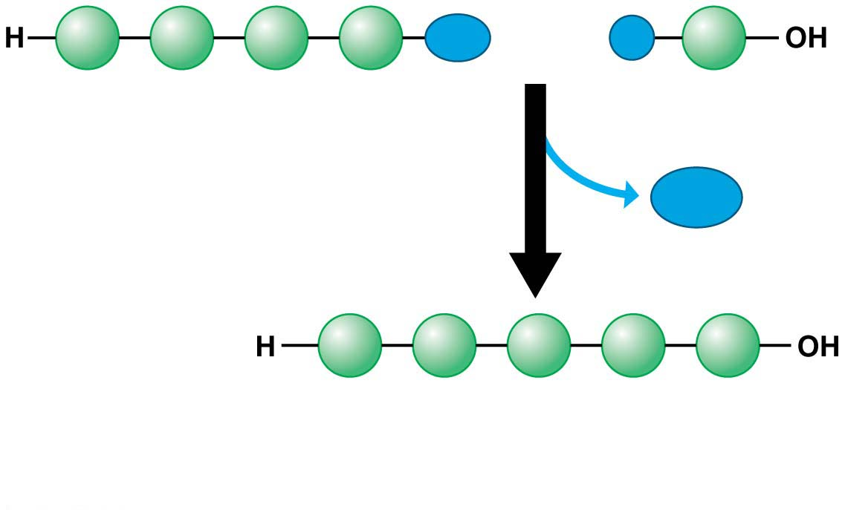
Giant Molecules from Smaller Building Blocks
On a molecular scale, many of life’s molecules are gigantic macromolecules고분자.
Three categories of macromolecules are
Carbohydrates탄수화물,
Proteins단백질, and
nucleic acids핵산.
Macromolecules are polymers.
Polymers중합체 are made by stringing together many smaller molecules called monomers단위체.
A dehydration reaction탈수반응
links two monomers together and
removes a molecule of water.
Dehydration reaction
Notes:
6
Student Misconceptions and Concerns
1. General biology students might not have previously taken a chemistry course. The concept of molecular building blocks that cannot be seen can be abstract and difficult to comprehend for such students. Concrete examples from our diets and good images will increase comprehension.
2. Students might need to be reminded about the levels of biological organization. The relationship between atoms, monomers, and polymers can be confusing. Consider noting these relationships somewhere in the classroom (such as on the board) where students can quickly glance for reassurance.
Teaching Tips
1. One of the great advantages of carbon is its ability to form up to four bonds, permitting the assembly of diverse components and branching configurations. Challenge your students to find another element that might also permit this sort of adaptability. (Like carbon, silicon has four electrons in its outer shell.)
2. Toothpicks and gumdrops (or any other pliable small candy) permit the quick construction of chemical models. Different candy colors can represent certain atoms. The model of the methane molecule in Figure 3.2 can thus easily be demonstrated (and consumed!).
3. A drill with interchangeable drill bits is a nice analogy to carbon skeletons with different functional groups. The analogy supports the role of different functions with different structures.
4. The author notes that a polymer is a like a pearl necklace made of many pearl “monomers.”
5. Train cars linking together to form a train is another nice analogy to monomers linking to form polymers. Consider adding that as the train cars are joined, a puff of steam appears—thus, the reference to water production and a dehydration reaction when linking molecular monomers.
Active Lecture Tips
1. See the Activity Reviewing Macromolecules on the Instructor Exchange. Visit the Instructor Exchange in the MasteringBiology instructor resource area for a description of this activity.

Slide 7
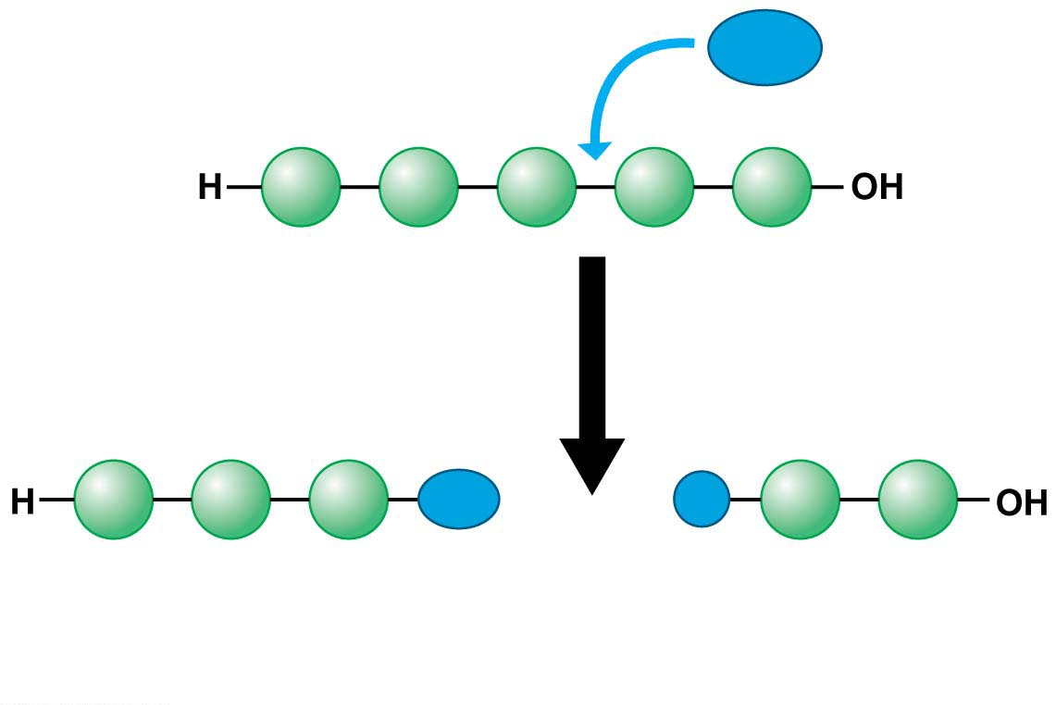
Organisms also have to break down macromolecules.
Digestion breaks down macromolecules to make monomers available to your cells.
Hydrolysis가수분해
breaks bonds between monomers, adds a molecule of water, and reverses the dehydration reaction.
Notes:
7
Student Misconceptions and Concerns
1. General biology students might not have previously taken a chemistry course. The concept of molecular building blocks that cannot be seen can be abstract and difficult to comprehend for such students. Concrete examples from our diets and good images will increase comprehension.
2. Students might need to be reminded about the levels of biological organization. The relationship between atoms, monomers, and polymers can be confusing. Consider noting these relationships somewhere in the classroom (such as on the board) where students can quickly glance for reassurance.
Teaching Tips
1. One of the great advantages of carbon is its ability to form up to four bonds, permitting the assembly of diverse components and branching configurations. Challenge your students to find another element that might also permit this sort of adaptability. (Like carbon, silicon has four electrons in its outer shell.)
2. Toothpicks and gumdrops (or any other pliable small candy) permit the quick construction of chemical models. Different candy colors can represent certain atoms. The model of the methane molecule in Figure 3.2 can thus easily be demonstrated (and consumed!).
3. A drill with interchangeable drill bits is a nice analogy to carbon skeletons with different functional groups. The analogy supports the role of different functions with different structures.
4. The author notes that a polymer is a like a pearl necklace made of many pearl “monomers.”
5. Train cars linking together to form a train is another nice analogy to monomers linking to form polymers. Consider adding that as the train cars are joined, a puff of steam appears—thus, the reference to water production and a dehydration reaction when linking molecular monomers.
Active Lecture Tips
1. See the Activity Reviewing Macromolecules on the Instructor Exchange. Visit the Instructor Exchange in the MasteringBiology instructor resource area for a description of this activity.

Slide 8
Large Biological Molecules
There are four categories of large biological molecules found in all living creatures:
Carbohydrates탄수화물,
Lipids지질,
Proteins단백질, and
nucleic acids핵산.
Notes:
8
Student Misconceptions and Concerns
1. The abstract nature of chemistry can be discouraging to many students. Consider starting out this section of the lecture by examining the chemical groups on a food nutrition label. Candy bars with peanuts are particularly useful as they contain significant amounts of all three sources of calories (carbohydrates, proteins, and lipids).
2. Students might struggle to extrapolate the properties of lipids to their roles in an organism. Ducks float because their feathers repel water instead of attracting it. Hair on your head remains flexible because of oils produced in your scalp. Examples such as these help connect the abstract properties of lipids to concrete examples in our world.
3. The functional significance of protein shape is an abstract molecular example of form and function relationships, which might be new to some students. The binding of an enzyme to its substrate is a type of molecular handshake, which permits specific interactions. To help students think about form and function relationships, share some concrete analogies in their lives—perhaps flathead and Phillips screwdrivers that match the proper type of screws or the fit of a hand into a glove.
4. The evolution of lactose tolerance within human groups in East Africa does not represent a deliberate decision, yet this evolutionary change appears logical. Many students perceive adaptations as deliberate events with purpose. As students develop a better understanding of the mechanisms of evolution, it will be important to point out that mutations arise by chance, with the culling hand of natural selection favoring traits that convey an advantage. Organisms cannot plan evolutionary change.
Teaching Tips
1. Consider reinforcing the three main sources of calories with food items that clearly represent each group. Bring clear examples to class as visual references, for example, a can of Coke or a bag of sugar for carbohydrates, a tub of margarine for lipids, and some beef jerky for protein (although some fat and carbohydrates might also be included).
2. If your lectures will eventually include details of glycolysis and aerobic respiration, this is a good point to introduce the basic concepts of glucose as fuel. Just introducing this conceptual formula might help: eating glucose + breathing in oxygen (yields) water + usable energy (used to build ATP) + heat + exhaled CO₂.
3. The section about our use of sugars may be of considerable interest to your students, who might not be expecting much interest in a lecture about organic chemistry. Consider an assignment for each student to bring to class a product label indicating high-fructose corn syrup (HFCS) as an ingredient.
4. Learning the definitions of word roots is invaluable when learning science. Learning the meaning of the prefix word roots “mono” (one), “di” (two), and “poly” (many) helps to distinguish the structures of various carbohydrates.
5. Consider an assignment for students to find reliable sources that discuss high sugar consumption in the modern diet. The key, of course, is in the quality of the resource. Consider narrowing down the categories to certain nonprofit health organizations (American Cancer Society, American Heart Association, and the like) and peer-reviewed journals.
6. A simple exercise demonstrates the enzymatic breakdown of starches into sugars. If students place an unsalted cracker in their mouths, holding it in their mouths while it mixes well with saliva, they might soon notice that a sweeter taste begins to emerge. The salivary enzyme amylase begins the digestion of starches into disaccharides, which may be degraded further by other enzymes. These disaccharides are the source of the sweet taste.
7. An adult human may store about a half of a kilogram of glycogen in the liver and muscles of the body, depending on recent dietary habits. A person who begins dieting might soon notice an immediate weight loss of 2–4 pounds (1–2 kilograms) over several days, reflecting reductions in stored glycogen, water, and intestinal contents (among other factors).
8. Another simple demonstration can illustrate hydrophobic and hydrophilic substances. In front of the class, mix colored water and a yellow oil (corn or canola oil work well). Shake up the mixture and then watch as the two separate. (You may have a mixture already made that remains separated; however, the dyes may bleed between the oil and the water.)
9. Margarine in stores commonly comes in liquid squeeze containers, in tubs, and in sticks. These forms reflect increasing amounts of hydrogenation, gradually increasing the stiffness from a liquid, to a firmer spread, to a firm stick of margarine. As noted in the text, recent studies have suggested that unsaturated oils become increasingly unhealthy as they are hydrogenated. Perhaps your students can find references to this correlation on the Internet.
10. Many analogies can help students understand the diversity of proteins that can be made from just 20 amino acids. The authors note that our language uses combinations of 26 letters to form words. Proteins are much longer “words,” creating even more diversity. Another analogy is to trains. This builds on the earlier analogy when polymers were introduced. Imagine making different trains about 100 cars long, using any combination of 20 types of railroad cars. Mathematically, the number of possible trains is 20¹⁰⁰, a number beyond imagination.
11. The authors note that the difference between a polypeptide and a protein is analogous to the relationship between a long strand of yarn and a sweater knitted from yarn. Proteins are clearly more complex!
12. Most cooking results in changes in the texture and color of a food. The brown color of a steak is the product of the denaturation of proteins. Fixatives such as formalin also denature proteins and cause color changes. Students who have dissected vertebrates will realize that the brown color of the muscles makes it look as if the animal has been cooked.
13. The “NA” in DNA and RNA stands for “nucleic acid.” Students often do not make this association without assistance.
Active Lecture Tips
1. The cellophane wrap often used to package foods is a biodegradable material derived from cellulose. Challenge students to work in pairs to create a list of other cellulose-derived products (such as paper).
2. Consider this assignment to finish a discussion of the diverse organic molecules in our diets. Have students work in pairs or small groups to analyze a food label listing the components of a McDonald’s Big Mac. Note the most abundant organic molecule class (perhaps by weight) found in each component.
3. See the Activity What Ingredients Make Up Your Snack Food on the Instructor Exchange. Visit the Instructor Exchange in the MasteringBiology instructor resource area for a description of this activity.
4. See the Activity Drawing Hydrophobic and Hydrophilic Interactions on the Instructor Exchange. Visit the Instructor Exchange in the MasteringBiology instructor resource area for a description of this activity.

Slide 9
Carbohydrates
Carbohydrates include sugars and polymers of sugar당.
In animals, carbohydrates are
a primary source of dietary energy and
raw material for manufacturing other kinds of organic compounds.
In plants, carbohydrates serve as a building material for much of the plant body.
Notes:
9
Student Misconceptions and Concerns
1. The abstract nature of chemistry can be discouraging to many students. Consider starting out this section of the lecture by examining the chemical groups on a food nutrition label. Candy bars with peanuts are particularly useful as they contain significant amounts of all three sources of calories (carbohydrates, proteins, and lipids).
2. Students might struggle to extrapolate the properties of lipids to their roles in an organism. Ducks float because their feathers repel water instead of attracting it. Hair on your head remains flexible because of oils produced in your scalp. Examples such as these help connect the abstract properties of lipids to concrete examples in our world.
3. The functional significance of protein shape is an abstract molecular example of form and function relationships, which might be new to some students. The binding of an enzyme to its substrate is a type of molecular handshake, which permits specific interactions. To help students think about form and function relationships, share some concrete analogies in their lives—perhaps flathead and Phillips screwdrivers that match the proper type of screws or the fit of a hand into a glove.
4. The evolution of lactose tolerance within human groups in East Africa does not represent a deliberate decision, yet this evolutionary change appears logical. Many students perceive adaptations as deliberate events with purpose. As students develop a better understanding of the mechanisms of evolution, it will be important to point out that mutations arise by chance, with the culling hand of natural selection favoring traits that convey an advantage. Organisms cannot plan evolutionary change.
Teaching Tips
1. Consider reinforcing the three main sources of calories with food items that clearly represent each group. Bring clear examples to class as visual references, for example, a can of Coke or a bag of sugar for carbohydrates, a tub of margarine for lipids, and some beef jerky for protein (although some fat and carbohydrates might also be included).
2. If your lectures will eventually include details of glycolysis and aerobic respiration, this is a good point to introduce the basic concepts of glucose as fuel. Just introducing this conceptual formula might help: eating glucose + breathing in oxygen (yields) water + usable energy (used to build ATP) + heat + exhaled CO₂.
3. The section about our use of sugars may be of considerable interest to your students, who might not be expecting much interest in a lecture about organic chemistry. Consider an assignment for each student to bring to class a product label indicating high-fructose corn syrup (HFCS) as an ingredient.
4. Learning the definitions of word roots is invaluable when learning science. Learning the meaning of the prefix word roots “mono” (one), “di” (two), and “poly” (many) helps to distinguish the structures of various carbohydrates.
5. Consider an assignment for students to find reliable sources that discuss high sugar consumption in the modern diet. The key, of course, is in the quality of the resource. Consider narrowing down the categories to certain nonprofit health organizations (American Cancer Society, American Heart Association, and the like) and peer-reviewed journals.
6. A simple exercise demonstrates the enzymatic breakdown of starches into sugars. If students place an unsalted cracker in their mouths, holding it in their mouths while it mixes well with saliva, they might soon notice that a sweeter taste begins to emerge. The salivary enzyme amylase begins the digestion of starches into disaccharides, which may be degraded further by other enzymes. These disaccharides are the source of the sweet taste.
7. An adult human may store about a half of a kilogram of glycogen in the liver and muscles of the body, depending on recent dietary habits. A person who begins dieting might soon notice an immediate weight loss of 2–4 pounds (1–2 kilograms) over several days, reflecting reductions in stored glycogen, water, and intestinal contents (among other factors).
8. Another simple demonstration can illustrate hydrophobic and hydrophilic substances. In front of the class, mix colored water and a yellow oil (corn or canola oil work well). Shake up the mixture and then watch as the two separate. (You may have a mixture already made that remains separated; however, the dyes may bleed between the oil and the water.)
9. Margarine in stores commonly comes in liquid squeeze containers, in tubs, and in sticks. These forms reflect increasing amounts of hydrogenation, gradually increasing the stiffness from a liquid, to a firmer spread, to a firm stick of margarine. As noted in the text, recent studies have suggested that unsaturated oils become increasingly unhealthy as they are hydrogenated. Perhaps your students can find references to this correlation on the Internet.
10. Many analogies can help students understand the diversity of proteins that can be made from just 20 amino acids. The authors note that our language uses combinations of 26 letters to form words. Proteins are much longer “words,” creating even more diversity. Another analogy is to trains. This builds on the earlier analogy when polymers were introduced. Imagine making different trains about 100 cars long, using any combination of 20 types of railroad cars. Mathematically, the number of possible trains is 20¹⁰⁰, a number beyond imagination.
11. The authors note that the difference between a polypeptide and a protein is analogous to the relationship between a long strand of yarn and a sweater knitted from yarn. Proteins are clearly more complex!
12. Most cooking results in changes in the texture and color of a food. The brown color of a steak is the product of the denaturation of proteins. Fixatives such as formalin also denature proteins and cause color changes. Students who have dissected vertebrates will realize that the brown color of the muscles makes it look as if the animal has been cooked.
13. The “NA” in DNA and RNA stands for “nucleic acid.” Students often do not make this association without assistance.
Active Lecture Tips
1. The cellophane wrap often used to package foods is a biodegradable material derived from cellulose. Challenge students to work in pairs to create a list of other cellulose-derived products (such as paper).
2. Consider this assignment to finish a discussion of the diverse organic molecules in our diets. Have students work in pairs or small groups to analyze a food label listing the components of a McDonald’s Big Mac. Note the most abundant organic molecule class (perhaps by weight) found in each component.
3. See the Activity What Ingredients Make Up Your Snack Food on the Instructor Exchange. Visit the Instructor Exchange in the MasteringBiology instructor resource area for a description of this activity.
4. See the Activity Drawing Hydrophobic and Hydrophilic Interactions on the Instructor Exchange. Visit the Instructor Exchange in the MasteringBiology instructor resource area for a description of this activity.

Slide 10
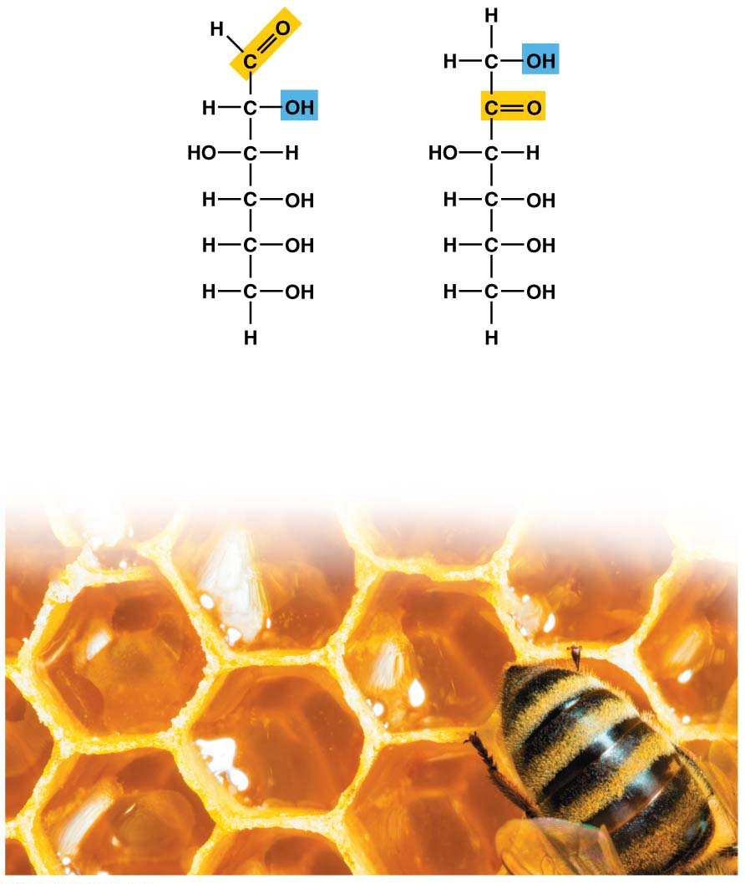
Monosaccharides단당류
Monosaccharides
are the monomers of carbohydrates and
cannot be broken down into smaller sugars.
Common examples are
glucose in sports drinks
and fructose found in fruit.
Both of these simple sugars
are also in honey.
Glucose
Fructose
C₆H₁₂O₆
C₆H₁₂O₆
Isomers
(same formula, different arrangements)
Notes:
10
Student Misconceptions and Concerns
1. The abstract nature of chemistry can be discouraging to many students. Consider starting out this section of the lecture by examining the chemical groups on a food nutrition label. Candy bars with peanuts are particularly useful as they contain significant amounts of all three sources of calories (carbohydrates, proteins, and lipids).
2. Students might struggle to extrapolate the properties of lipids to their roles in an organism. Ducks float because their feathers repel water instead of attracting it. Hair on your head remains flexible because of oils produced in your scalp. Examples such as these help connect the abstract properties of lipids to concrete examples in our world.
3. The functional significance of protein shape is an abstract molecular example of form and function relationships, which might be new to some students. The binding of an enzyme to its substrate is a type of molecular handshake, which permits specific interactions. To help students think about form and function relationships, share some concrete analogies in their lives—perhaps flathead and Phillips screwdrivers that match the proper type of screws or the fit of a hand into a glove.
4. The evolution of lactose tolerance within human groups in East Africa does not represent a deliberate decision, yet this evolutionary change appears logical. Many students perceive adaptations as deliberate events with purpose. As students develop a better understanding of the mechanisms of evolution, it will be important to point out that mutations arise by chance, with the culling hand of natural selection favoring traits that convey an advantage. Organisms cannot plan evolutionary change.
Teaching Tips
1. Consider reinforcing the three main sources of calories with food items that clearly represent each group. Bring clear examples to class as visual references, for example, a can of Coke or a bag of sugar for carbohydrates, a tub of margarine for lipids, and some beef jerky for protein (although some fat and carbohydrates might also be included).
2. If your lectures will eventually include details of glycolysis and aerobic respiration, this is a good point to introduce the basic concepts of glucose as fuel. Just introducing this conceptual formula might help: eating glucose + breathing in oxygen (yields) water + usable energy (used to build ATP) + heat + exhaled CO₂.
3. The section about our use of sugars may be of considerable interest to your students, who might not be expecting much interest in a lecture about organic chemistry. Consider an assignment for each student to bring to class a product label indicating high-fructose corn syrup (HFCS) as an ingredient.
4. Learning the definitions of word roots is invaluable when learning science. Learning the meaning of the prefix word roots “mono” (one), “di” (two), and “poly” (many) helps to distinguish the structures of various carbohydrates.
5. Consider an assignment for students to find reliable sources that discuss high sugar consumption in the modern diet. The key, of course, is in the quality of the resource. Consider narrowing down the categories to certain nonprofit health organizations (American Cancer Society, American Heart Association, and the like) and peer-reviewed journals.
6. A simple exercise demonstrates the enzymatic breakdown of starches into sugars. If students place an unsalted cracker in their mouths, holding it in their mouths while it mixes well with saliva, they might soon notice that a sweeter taste begins to emerge. The salivary enzyme amylase begins the digestion of starches into disaccharides, which may be degraded further by other enzymes. These disaccharides are the source of the sweet taste.
7. An adult human may store about a half of a kilogram of glycogen in the liver and muscles of the body, depending on recent dietary habits. A person who begins dieting might soon notice an immediate weight loss of 2–4 pounds (1–2 kilograms) over several days, reflecting reductions in stored glycogen, water, and intestinal contents (among other factors).
8. Another simple demonstration can illustrate hydrophobic and hydrophilic substances. In front of the class, mix colored water and a yellow oil (corn or canola oil work well). Shake up the mixture and then watch as the two separate. (You may have a mixture already made that remains separated; however, the dyes may bleed between the oil and the water.)
9. Margarine in stores commonly comes in liquid squeeze containers, in tubs, and in sticks. These forms reflect increasing amounts of hydrogenation, gradually increasing the stiffness from a liquid, to a firmer spread, to a firm stick of margarine. As noted in the text, recent studies have suggested that unsaturated oils become increasingly unhealthy as they are hydrogenated. Perhaps your students can find references to this correlation on the Internet.
10. Many analogies can help students understand the diversity of proteins that can be made from just 20 amino acids. The authors note that our language uses combinations of 26 letters to form words. Proteins are much longer “words,” creating even more diversity. Another analogy is to trains. This builds on the earlier analogy when polymers were introduced. Imagine making different trains about 100 cars long, using any combination of 20 types of railroad cars. Mathematically, the number of possible trains is 20¹⁰⁰, a number beyond imagination.
11. The authors note that the difference between a polypeptide and a protein is analogous to the relationship between a long strand of yarn and a sweater knitted from yarn. Proteins are clearly more complex!
12. Most cooking results in changes in the texture and color of a food. The brown color of a steak is the product of the denaturation of proteins. Fixatives such as formalin also denature proteins and cause color changes. Students who have dissected vertebrates will realize that the brown color of the muscles makes it look as if the animal has been cooked.
13. The “NA” in DNA and RNA stands for “nucleic acid.” Students often do not make this association without assistance.
Active Lecture Tips
1. The cellophane wrap often used to package foods is a biodegradable material derived from cellulose. Challenge students to work in pairs to create a list of other cellulose-derived products (such as paper).
2. Consider this assignment to finish a discussion of the diverse organic molecules in our diets. Have students work in pairs or small groups to analyze a food label listing the components of a McDonald’s Big Mac. Note the most abundant organic molecule class (perhaps by weight) found in each component.
3. See the Activity What Ingredients Make Up Your Snack Food on the Instructor Exchange. Visit the Instructor Exchange in the MasteringBiology instructor resource area for a description of this activity.
4. See the Activity Drawing Hydrophobic and Hydrophilic Interactions on the Instructor Exchange. Visit the Instructor Exchange in the MasteringBiology instructor resource area for a description of this activity.

Slide 11
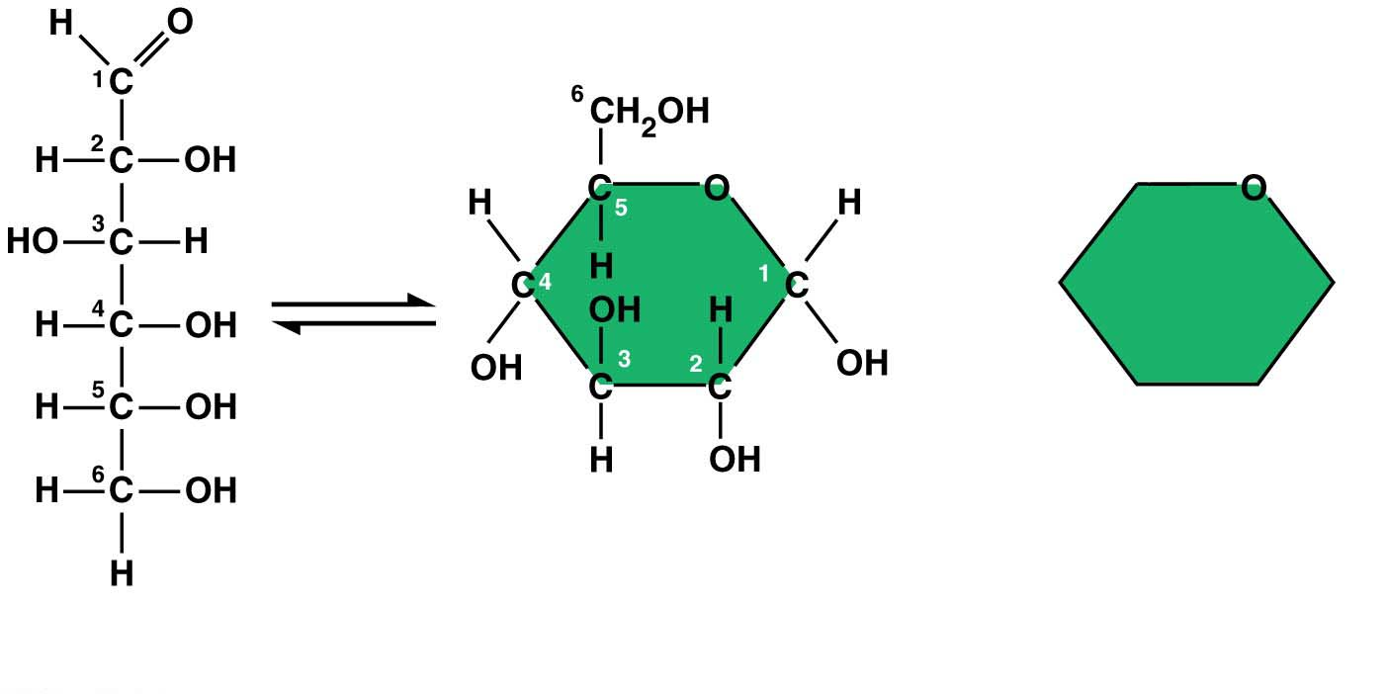
Monosaccharides, particularly glucose, are the main fuels for cellular work.
In water, many monosaccharides form rings.
(b) Abbreviated ring
structure
(a) Linear and ring structures 포도당 glucose
Notes:
11
Student Misconceptions and Concerns
1. The abstract nature of chemistry can be discouraging to many students. Consider starting out this section of the lecture by examining the chemical groups on a food nutrition label. Candy bars with peanuts are particularly useful as they contain significant amounts of all three sources of calories (carbohydrates, proteins, and lipids).
2. Students might struggle to extrapolate the properties of lipids to their roles in an organism. Ducks float because their feathers repel water instead of attracting it. Hair on your head remains flexible because of oils produced in your scalp. Examples such as these help connect the abstract properties of lipids to concrete examples in our world.
3. The functional significance of protein shape is an abstract molecular example of form and function relationships, which might be new to some students. The binding of an enzyme to its substrate is a type of molecular handshake, which permits specific interactions. To help students think about form and function relationships, share some concrete analogies in their lives—perhaps flathead and Phillips screwdrivers that match the proper type of screws or the fit of a hand into a glove.
4. The evolution of lactose tolerance within human groups in East Africa does not represent a deliberate decision, yet this evolutionary change appears logical. Many students perceive adaptations as deliberate events with purpose. As students develop a better understanding of the mechanisms of evolution, it will be important to point out that mutations arise by chance, with the culling hand of natural selection favoring traits that convey an advantage. Organisms cannot plan evolutionary change.
Teaching Tips
1. Consider reinforcing the three main sources of calories with food items that clearly represent each group. Bring clear examples to class as visual references, for example, a can of Coke or a bag of sugar for carbohydrates, a tub of margarine for lipids, and some beef jerky for protein (although some fat and carbohydrates might also be included).
2. If your lectures will eventually include details of glycolysis and aerobic respiration, this is a good point to introduce the basic concepts of glucose as fuel. Just introducing this conceptual formula might help: eating glucose + breathing in oxygen (yields) water + usable energy (used to build ATP) + heat + exhaled CO₂.
3. The section about our use of sugars may be of considerable interest to your students, who might not be expecting much interest in a lecture about organic chemistry. Consider an assignment for each student to bring to class a product label indicating high-fructose corn syrup (HFCS) as an ingredient.
4. Learning the definitions of word roots is invaluable when learning science. Learning the meaning of the prefix word roots “mono” (one), “di” (two), and “poly” (many) helps to distinguish the structures of various carbohydrates.
5. Consider an assignment for students to find reliable sources that discuss high sugar consumption in the modern diet. The key, of course, is in the quality of the resource. Consider narrowing down the categories to certain nonprofit health organizations (American Cancer Society, American Heart Association, and the like) and peer-reviewed journals.
6. A simple exercise demonstrates the enzymatic breakdown of starches into sugars. If students place an unsalted cracker in their mouths, holding it in their mouths while it mixes well with saliva, they might soon notice that a sweeter taste begins to emerge. The salivary enzyme amylase begins the digestion of starches into disaccharides, which may be degraded further by other enzymes. These disaccharides are the source of the sweet taste.
7. An adult human may store about a half of a kilogram of glycogen in the liver and muscles of the body, depending on recent dietary habits. A person who begins dieting might soon notice an immediate weight loss of 2–4 pounds (1–2 kilograms) over several days, reflecting reductions in stored glycogen, water, and intestinal contents (among other factors).
8. Another simple demonstration can illustrate hydrophobic and hydrophilic substances. In front of the class, mix colored water and a yellow oil (corn or canola oil work well). Shake up the mixture and then watch as the two separate. (You may have a mixture already made that remains separated; however, the dyes may bleed between the oil and the water.)
9. Margarine in stores commonly comes in liquid squeeze containers, in tubs, and in sticks. These forms reflect increasing amounts of hydrogenation, gradually increasing the stiffness from a liquid, to a firmer spread, to a firm stick of margarine. As noted in the text, recent studies have suggested that unsaturated oils become increasingly unhealthy as they are hydrogenated. Perhaps your students can find references to this correlation on the Internet.
10. Many analogies can help students understand the diversity of proteins that can be made from just 20 amino acids. The authors note that our language uses combinations of 26 letters to form words. Proteins are much longer “words,” creating even more diversity. Another analogy is to trains. This builds on the earlier analogy when polymers were introduced. Imagine making different trains about 100 cars long, using any combination of 20 types of railroad cars. Mathematically, the number of possible trains is 20¹⁰⁰, a number beyond imagination.
11. The authors note that the difference between a polypeptide and a protein is analogous to the relationship between a long strand of yarn and a sweater knitted from yarn. Proteins are clearly more complex!
12. Most cooking results in changes in the texture and color of a food. The brown color of a steak is the product of the denaturation of proteins. Fixatives such as formalin also denature proteins and cause color changes. Students who have dissected vertebrates will realize that the brown color of the muscles makes it look as if the animal has been cooked.
13. The “NA” in DNA and RNA stands for “nucleic acid.” Students often do not make this association without assistance.
Active Lecture Tips
1. The cellophane wrap often used to package foods is a biodegradable material derived from cellulose. Challenge students to work in pairs to create a list of other cellulose-derived products (such as paper).
2. Consider this assignment to finish a discussion of the diverse organic molecules in our diets. Have students work in pairs or small groups to analyze a food label listing the components of a McDonald’s Big Mac. Note the most abundant organic molecule class (perhaps by weight) found in each component.
3. See the Activity What Ingredients Make Up Your Snack Food on the Instructor Exchange. Visit the Instructor Exchange in the MasteringBiology instructor resource area for a description of this activity.
4. See the Activity Drawing Hydrophobic and Hydrophilic Interactions on the Instructor Exchange. Visit the Instructor Exchange in the MasteringBiology instructor resource area for a description of this activity.

Slide 12
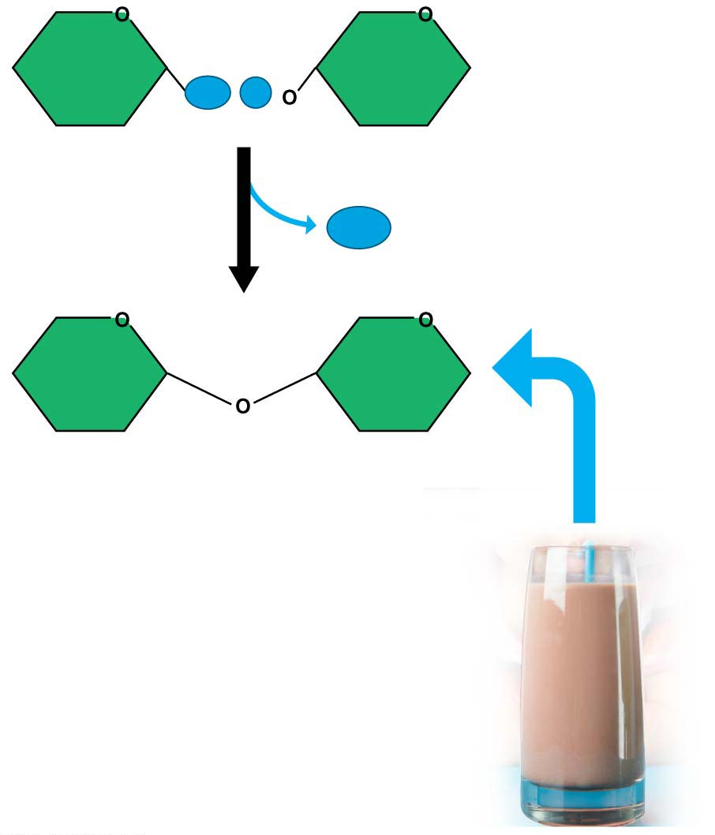
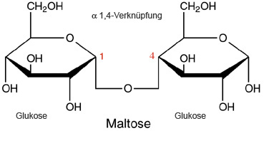
Disaccharides이당류
A disaccharide is a double sugar constructed from two monosaccharides by a dehydration reaction.
lactose in milk, made from the monosaccharides glucose and galactose,
maltose in beer, malted milk shakes, and malted milk ball candy, and
sucrose in table sugar.
Glucose
Galactose
Lactose
Notes:
12
Student Misconceptions and Concerns
1. The abstract nature of chemistry can be discouraging to many students. Consider starting out this section of the lecture by examining the chemical groups on a food nutrition label. Candy bars with peanuts are particularly useful as they contain significant amounts of all three sources of calories (carbohydrates, proteins, and lipids).
2. Students might struggle to extrapolate the properties of lipids to their roles in an organism. Ducks float because their feathers repel water instead of attracting it. Hair on your head remains flexible because of oils produced in your scalp. Examples such as these help connect the abstract properties of lipids to concrete examples in our world.
3. The functional significance of protein shape is an abstract molecular example of form and function relationships, which might be new to some students. The binding of an enzyme to its substrate is a type of molecular handshake, which permits specific interactions. To help students think about form and function relationships, share some concrete analogies in their lives—perhaps flathead and Phillips screwdrivers that match the proper type of screws or the fit of a hand into a glove.
4. The evolution of lactose tolerance within human groups in East Africa does not represent a deliberate decision, yet this evolutionary change appears logical. Many students perceive adaptations as deliberate events with purpose. As students develop a better understanding of the mechanisms of evolution, it will be important to point out that mutations arise by chance, with the culling hand of natural selection favoring traits that convey an advantage. Organisms cannot plan evolutionary change.
Teaching Tips
1. Consider reinforcing the three main sources of calories with food items that clearly represent each group. Bring clear examples to class as visual references, for example, a can of Coke or a bag of sugar for carbohydrates, a tub of margarine for lipids, and some beef jerky for protein (although some fat and carbohydrates might also be included).
2. If your lectures will eventually include details of glycolysis and aerobic respiration, this is a good point to introduce the basic concepts of glucose as fuel. Just introducing this conceptual formula might help: eating glucose + breathing in oxygen (yields) water + usable energy (used to build ATP) + heat + exhaled CO₂.
3. The section about our use of sugars may be of considerable interest to your students, who might not be expecting much interest in a lecture about organic chemistry. Consider an assignment for each student to bring to class a product label indicating high-fructose corn syrup (HFCS) as an ingredient.
4. Learning the definitions of word roots is invaluable when learning science. Learning the meaning of the prefix word roots “mono” (one), “di” (two), and “poly” (many) helps to distinguish the structures of various carbohydrates.
5. Consider an assignment for students to find reliable sources that discuss high sugar consumption in the modern diet. The key, of course, is in the quality of the resource. Consider narrowing down the categories to certain nonprofit health organizations (American Cancer Society, American Heart Association, and the like) and peer-reviewed journals.
6. A simple exercise demonstrates the enzymatic breakdown of starches into sugars. If students place an unsalted cracker in their mouths, holding it in their mouths while it mixes well with saliva, they might soon notice that a sweeter taste begins to emerge. The salivary enzyme amylase begins the digestion of starches into disaccharides, which may be degraded further by other enzymes. These disaccharides are the source of the sweet taste.
7. An adult human may store about a half of a kilogram of glycogen in the liver and muscles of the body, depending on recent dietary habits. A person who begins dieting might soon notice an immediate weight loss of 2–4 pounds (1–2 kilograms) over several days, reflecting reductions in stored glycogen, water, and intestinal contents (among other factors).
8. Another simple demonstration can illustrate hydrophobic and hydrophilic substances. In front of the class, mix colored water and a yellow oil (corn or canola oil work well). Shake up the mixture and then watch as the two separate. (You may have a mixture already made that remains separated; however, the dyes may bleed between the oil and the water.)
9. Margarine in stores commonly comes in liquid squeeze containers, in tubs, and in sticks. These forms reflect increasing amounts of hydrogenation, gradually increasing the stiffness from a liquid, to a firmer spread, to a firm stick of margarine. As noted in the text, recent studies have suggested that unsaturated oils become increasingly unhealthy as they are hydrogenated. Perhaps your students can find references to this correlation on the Internet.
10. Many analogies can help students understand the diversity of proteins that can be made from just 20 amino acids. The authors note that our language uses combinations of 26 letters to form words. Proteins are much longer “words,” creating even more diversity. Another analogy is to trains. This builds on the earlier analogy when polymers were introduced. Imagine making different trains about 100 cars long, using any combination of 20 types of railroad cars. Mathematically, the number of possible trains is 20¹⁰⁰, a number beyond imagination.
11. The authors note that the difference between a polypeptide and a protein is analogous to the relationship between a long strand of yarn and a sweater knitted from yarn. Proteins are clearly more complex!
12. Most cooking results in changes in the texture and color of a food. The brown color of a steak is the product of the denaturation of proteins. Fixatives such as formalin also denature proteins and cause color changes. Students who have dissected vertebrates will realize that the brown color of the muscles makes it look as if the animal has been cooked.
13. The “NA” in DNA and RNA stands for “nucleic acid.” Students often do not make this association without assistance.
Active Lecture Tips
1. The cellophane wrap often used to package foods is a biodegradable material derived from cellulose. Challenge students to work in pairs to create a list of other cellulose-derived products (such as paper).
2. Consider this assignment to finish a discussion of the diverse organic molecules in our diets. Have students work in pairs or small groups to analyze a food label listing the components of a McDonald’s Big Mac. Note the most abundant organic molecule class (perhaps by weight) found in each component.
3. See the Activity What Ingredients Make Up Your Snack Food on the Instructor Exchange. Visit the Instructor Exchange in the MasteringBiology instructor resource area for a description of this activity.
4. See the Activity Drawing Hydrophobic and Hydrophilic Interactions on the Instructor Exchange. Visit the Instructor Exchange in the MasteringBiology instructor resource area for a description of this activity.

Slide 13
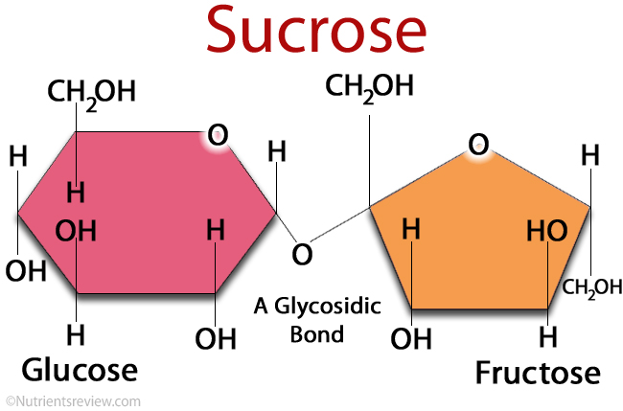
Sucrose is the main carbohydrate in plant sap.
High-fructose corn syrup (HFCS) is made by a commercial process that converts natural glucose in corn syrup to much sweeter fructose.
Notes:
13
Student Misconceptions and Concerns
1. The abstract nature of chemistry can be discouraging to many students. Consider starting out this section of the lecture by examining the chemical groups on a food nutrition label. Candy bars with peanuts are particularly useful as they contain significant amounts of all three sources of calories (carbohydrates, proteins, and lipids).
2. Students might struggle to extrapolate the properties of lipids to their roles in an organism. Ducks float because their feathers repel water instead of attracting it. Hair on your head remains flexible because of oils produced in your scalp. Examples such as these help connect the abstract properties of lipids to concrete examples in our world.
3. The functional significance of protein shape is an abstract molecular example of form and function relationships, which might be new to some students. The binding of an enzyme to its substrate is a type of molecular handshake, which permits specific interactions. To help students think about form and function relationships, share some concrete analogies in their lives—perhaps flathead and Phillips screwdrivers that match the proper type of screws or the fit of a hand into a glove.
4. The evolution of lactose tolerance within human groups in East Africa does not represent a deliberate decision, yet this evolutionary change appears logical. Many students perceive adaptations as deliberate events with purpose. As students develop a better understanding of the mechanisms of evolution, it will be important to point out that mutations arise by chance, with the culling hand of natural selection favoring traits that convey an advantage. Organisms cannot plan evolutionary change.
Teaching Tips
1. Consider reinforcing the three main sources of calories with food items that clearly represent each group. Bring clear examples to class as visual references, for example, a can of Coke or a bag of sugar for carbohydrates, a tub of margarine for lipids, and some beef jerky for protein (although some fat and carbohydrates might also be included).
2. If your lectures will eventually include details of glycolysis and aerobic respiration, this is a good point to introduce the basic concepts of glucose as fuel. Just introducing this conceptual formula might help: eating glucose + breathing in oxygen (yields) water + usable energy (used to build ATP) + heat + exhaled CO₂.
3. The section about our use of sugars may be of considerable interest to your students, who might not be expecting much interest in a lecture about organic chemistry. Consider an assignment for each student to bring to class a product label indicating high-fructose corn syrup (HFCS) as an ingredient.
4. Learning the definitions of word roots is invaluable when learning science. Learning the meaning of the prefix word roots “mono” (one), “di” (two), and “poly” (many) helps to distinguish the structures of various carbohydrates.
5. Consider an assignment for students to find reliable sources that discuss high sugar consumption in the modern diet. The key, of course, is in the quality of the resource. Consider narrowing down the categories to certain nonprofit health organizations (American Cancer Society, American Heart Association, and the like) and peer-reviewed journals.
6. A simple exercise demonstrates the enzymatic breakdown of starches into sugars. If students place an unsalted cracker in their mouths, holding it in their mouths while it mixes well with saliva, they might soon notice that a sweeter taste begins to emerge. The salivary enzyme amylase begins the digestion of starches into disaccharides, which may be degraded further by other enzymes. These disaccharides are the source of the sweet taste.
7. An adult human may store about a half of a kilogram of glycogen in the liver and muscles of the body, depending on recent dietary habits. A person who begins dieting might soon notice an immediate weight loss of 2–4 pounds (1–2 kilograms) over several days, reflecting reductions in stored glycogen, water, and intestinal contents (among other factors).
8. Another simple demonstration can illustrate hydrophobic and hydrophilic substances. In front of the class, mix colored water and a yellow oil (corn or canola oil work well). Shake up the mixture and then watch as the two separate. (You may have a mixture already made that remains separated; however, the dyes may bleed between the oil and the water.)
9. Margarine in stores commonly comes in liquid squeeze containers, in tubs, and in sticks. These forms reflect increasing amounts of hydrogenation, gradually increasing the stiffness from a liquid, to a firmer spread, to a firm stick of margarine. As noted in the text, recent studies have suggested that unsaturated oils become increasingly unhealthy as they are hydrogenated. Perhaps your students can find references to this correlation on the Internet.
10. Many analogies can help students understand the diversity of proteins that can be made from just 20 amino acids. The authors note that our language uses combinations of 26 letters to form words. Proteins are much longer “words,” creating even more diversity. Another analogy is to trains. This builds on the earlier analogy when polymers were introduced. Imagine making different trains about 100 cars long, using any combination of 20 types of railroad cars. Mathematically, the number of possible trains is 20¹⁰⁰, a number beyond imagination.
11. The authors note that the difference between a polypeptide and a protein is analogous to the relationship between a long strand of yarn and a sweater knitted from yarn. Proteins are clearly more complex!
12. Most cooking results in changes in the texture and color of a food. The brown color of a steak is the product of the denaturation of proteins. Fixatives such as formalin also denature proteins and cause color changes. Students who have dissected vertebrates will realize that the brown color of the muscles makes it look as if the animal has been cooked.
13. The “NA” in DNA and RNA stands for “nucleic acid.” Students often do not make this association without assistance.
Active Lecture Tips
1. The cellophane wrap often used to package foods is a biodegradable material derived from cellulose. Challenge students to work in pairs to create a list of other cellulose-derived products (such as paper).
2. Consider this assignment to finish a discussion of the diverse organic molecules in our diets. Have students work in pairs or small groups to analyze a food label listing the components of a McDonald’s Big Mac. Note the most abundant organic molecule class (perhaps by weight) found in each component.
3. See the Activity What Ingredients Make Up Your Snack Food on the Instructor Exchange. Visit the Instructor Exchange in the MasteringBiology instructor resource area for a description of this activity.
4. See the Activity Drawing Hydrophobic and Hydrophilic Interactions on the Instructor Exchange. Visit the Instructor Exchange in the MasteringBiology instructor resource area for a description of this activity.

Slide 14
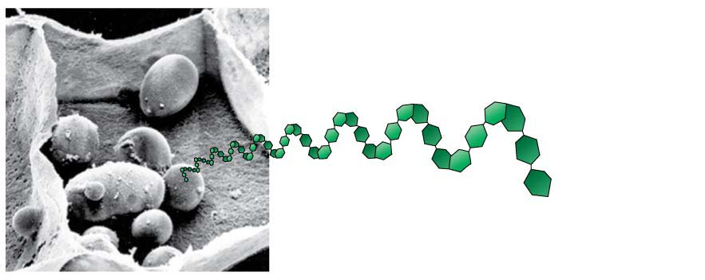
Polysaccharides다당류
Polysaccharides
are complex carbohydrates and
are made of long chains of sugars—polymers of monosaccharides.
Starch녹말
is a familiar example of a polysaccharide,
consists of long strings of glucose monomers, and
is used by plant cells to store energy.
Starch granules
in potato tuber cells
Notes:
14
Student Misconceptions and Concerns
1. The abstract nature of chemistry can be discouraging to many students. Consider starting out this section of the lecture by examining the chemical groups on a food nutrition label. Candy bars with peanuts are particularly useful as they contain significant amounts of all three sources of calories (carbohydrates, proteins, and lipids).
2. Students might struggle to extrapolate the properties of lipids to their roles in an organism. Ducks float because their feathers repel water instead of attracting it. Hair on your head remains flexible because of oils produced in your scalp. Examples such as these help connect the abstract properties of lipids to concrete examples in our world.
3. The functional significance of protein shape is an abstract molecular example of form and function relationships, which might be new to some students. The binding of an enzyme to its substrate is a type of molecular handshake, which permits specific interactions. To help students think about form and function relationships, share some concrete analogies in their lives—perhaps flathead and Phillips screwdrivers that match the proper type of screws or the fit of a hand into a glove.
4. The evolution of lactose tolerance within human groups in East Africa does not represent a deliberate decision, yet this evolutionary change appears logical. Many students perceive adaptations as deliberate events with purpose. As students develop a better understanding of the mechanisms of evolution, it will be important to point out that mutations arise by chance, with the culling hand of natural selection favoring traits that convey an advantage. Organisms cannot plan evolutionary change.
Teaching Tips
1. Consider reinforcing the three main sources of calories with food items that clearly represent each group. Bring clear examples to class as visual references, for example, a can of Coke or a bag of sugar for carbohydrates, a tub of margarine for lipids, and some beef jerky for protein (although some fat and carbohydrates might also be included).
2. If your lectures will eventually include details of glycolysis and aerobic respiration, this is a good point to introduce the basic concepts of glucose as fuel. Just introducing this conceptual formula might help: eating glucose + breathing in oxygen (yields) water + usable energy (used to build ATP) + heat + exhaled CO₂.
3. The section about our use of sugars may be of considerable interest to your students, who might not be expecting much interest in a lecture about organic chemistry. Consider an assignment for each student to bring to class a product label indicating high-fructose corn syrup (HFCS) as an ingredient.
4. Learning the definitions of word roots is invaluable when learning science. Learning the meaning of the prefix word roots “mono” (one), “di” (two), and “poly” (many) helps to distinguish the structures of various carbohydrates.
5. Consider an assignment for students to find reliable sources that discuss high sugar consumption in the modern diet. The key, of course, is in the quality of the resource. Consider narrowing down the categories to certain nonprofit health organizations (American Cancer Society, American Heart Association, and the like) and peer-reviewed journals.
6. A simple exercise demonstrates the enzymatic breakdown of starches into sugars. If students place an unsalted cracker in their mouths, holding it in their mouths while it mixes well with saliva, they might soon notice that a sweeter taste begins to emerge. The salivary enzyme amylase begins the digestion of starches into disaccharides, which may be degraded further by other enzymes. These disaccharides are the source of the sweet taste.
7. An adult human may store about a half of a kilogram of glycogen in the liver and muscles of the body, depending on recent dietary habits. A person who begins dieting might soon notice an immediate weight loss of 2–4 pounds (1–2 kilograms) over several days, reflecting reductions in stored glycogen, water, and intestinal contents (among other factors).
8. Another simple demonstration can illustrate hydrophobic and hydrophilic substances. In front of the class, mix colored water and a yellow oil (corn or canola oil work well). Shake up the mixture and then watch as the two separate. (You may have a mixture already made that remains separated; however, the dyes may bleed between the oil and the water.)
9. Margarine in stores commonly comes in liquid squeeze containers, in tubs, and in sticks. These forms reflect increasing amounts of hydrogenation, gradually increasing the stiffness from a liquid, to a firmer spread, to a firm stick of margarine. As noted in the text, recent studies have suggested that unsaturated oils become increasingly unhealthy as they are hydrogenated. Perhaps your students can find references to this correlation on the Internet.
10. Many analogies can help students understand the diversity of proteins that can be made from just 20 amino acids. The authors note that our language uses combinations of 26 letters to form words. Proteins are much longer “words,” creating even more diversity. Another analogy is to trains. This builds on the earlier analogy when polymers were introduced. Imagine making different trains about 100 cars long, using any combination of 20 types of railroad cars. Mathematically, the number of possible trains is 20¹⁰⁰, a number beyond imagination.
11. The authors note that the difference between a polypeptide and a protein is analogous to the relationship between a long strand of yarn and a sweater knitted from yarn. Proteins are clearly more complex!
12. Most cooking results in changes in the texture and color of a food. The brown color of a steak is the product of the denaturation of proteins. Fixatives such as formalin also denature proteins and cause color changes. Students who have dissected vertebrates will realize that the brown color of the muscles makes it look as if the animal has been cooked.
13. The “NA” in DNA and RNA stands for “nucleic acid.” Students often do not make this association without assistance.
Active Lecture Tips
1. The cellophane wrap often used to package foods is a biodegradable material derived from cellulose. Challenge students to work in pairs to create a list of other cellulose-derived products (such as paper).
2. Consider this assignment to finish a discussion of the diverse organic molecules in our diets. Have students work in pairs or small groups to analyze a food label listing the components of a McDonald’s Big Mac. Note the most abundant organic molecule class (perhaps by weight) found in each component.
3. See the Activity What Ingredients Make Up Your Snack Food on the Instructor Exchange. Visit the Instructor Exchange in the MasteringBiology instructor resource area for a description of this activity.
4. See the Activity Drawing Hydrophobic and Hydrophilic Interactions on the Instructor Exchange. Visit the Instructor Exchange in the MasteringBiology instructor resource area for a description of this activity.

Slide 15
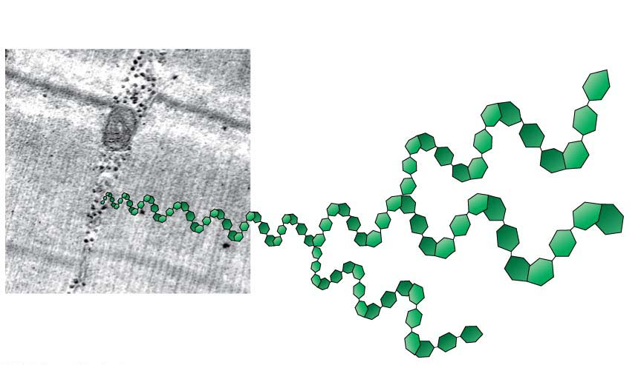
Glycogen
is used by animal cells to store energy and
is broken down to release glucose when you need energy.
Glycogen granules
in muscle
tissue
Notes:
15
Student Misconceptions and Concerns
1. The abstract nature of chemistry can be discouraging to many students. Consider starting out this section of the lecture by examining the chemical groups on a food nutrition label. Candy bars with peanuts are particularly useful as they contain significant amounts of all three sources of calories (carbohydrates, proteins, and lipids).
2. Students might struggle to extrapolate the properties of lipids to their roles in an organism. Ducks float because their feathers repel water instead of attracting it. Hair on your head remains flexible because of oils produced in your scalp. Examples such as these help connect the abstract properties of lipids to concrete examples in our world.
3. The functional significance of protein shape is an abstract molecular example of form and function relationships, which might be new to some students. The binding of an enzyme to its substrate is a type of molecular handshake, which permits specific interactions. To help students think about form and function relationships, share some concrete analogies in their lives—perhaps flathead and Phillips screwdrivers that match the proper type of screws or the fit of a hand into a glove.
4. The evolution of lactose tolerance within human groups in East Africa does not represent a deliberate decision, yet this evolutionary change appears logical. Many students perceive adaptations as deliberate events with purpose. As students develop a better understanding of the mechanisms of evolution, it will be important to point out that mutations arise by chance, with the culling hand of natural selection favoring traits that convey an advantage. Organisms cannot plan evolutionary change.
Teaching Tips
1. Consider reinforcing the three main sources of calories with food items that clearly represent each group. Bring clear examples to class as visual references, for example, a can of Coke or a bag of sugar for carbohydrates, a tub of margarine for lipids, and some beef jerky for protein (although some fat and carbohydrates might also be included).
2. If your lectures will eventually include details of glycolysis and aerobic respiration, this is a good point to introduce the basic concepts of glucose as fuel. Just introducing this conceptual formula might help: eating glucose + breathing in oxygen (yields) water + usable energy (used to build ATP) + heat + exhaled CO₂.
3. The section about our use of sugars may be of considerable interest to your students, who might not be expecting much interest in a lecture about organic chemistry. Consider an assignment for each student to bring to class a product label indicating high-fructose corn syrup (HFCS) as an ingredient.
4. Learning the definitions of word roots is invaluable when learning science. Learning the meaning of the prefix word roots “mono” (one), “di” (two), and “poly” (many) helps to distinguish the structures of various carbohydrates.
5. Consider an assignment for students to find reliable sources that discuss high sugar consumption in the modern diet. The key, of course, is in the quality of the resource. Consider narrowing down the categories to certain nonprofit health organizations (American Cancer Society, American Heart Association, and the like) and peer-reviewed journals.
6. A simple exercise demonstrates the enzymatic breakdown of starches into sugars. If students place an unsalted cracker in their mouths, holding it in their mouths while it mixes well with saliva, they might soon notice that a sweeter taste begins to emerge. The salivary enzyme amylase begins the digestion of starches into disaccharides, which may be degraded further by other enzymes. These disaccharides are the source of the sweet taste.
7. An adult human may store about a half of a kilogram of glycogen in the liver and muscles of the body, depending on recent dietary habits. A person who begins dieting might soon notice an immediate weight loss of 2–4 pounds (1–2 kilograms) over several days, reflecting reductions in stored glycogen, water, and intestinal contents (among other factors).
8. Another simple demonstration can illustrate hydrophobic and hydrophilic substances. In front of the class, mix colored water and a yellow oil (corn or canola oil work well). Shake up the mixture and then watch as the two separate. (You may have a mixture already made that remains separated; however, the dyes may bleed between the oil and the water.)
9. Margarine in stores commonly comes in liquid squeeze containers, in tubs, and in sticks. These forms reflect increasing amounts of hydrogenation, gradually increasing the stiffness from a liquid, to a firmer spread, to a firm stick of margarine. As noted in the text, recent studies have suggested that unsaturated oils become increasingly unhealthy as they are hydrogenated. Perhaps your students can find references to this correlation on the Internet.
10. Many analogies can help students understand the diversity of proteins that can be made from just 20 amino acids. The authors note that our language uses combinations of 26 letters to form words. Proteins are much longer “words,” creating even more diversity. Another analogy is to trains. This builds on the earlier analogy when polymers were introduced. Imagine making different trains about 100 cars long, using any combination of 20 types of railroad cars. Mathematically, the number of possible trains is 20¹⁰⁰, a number beyond imagination.
11. The authors note that the difference between a polypeptide and a protein is analogous to the relationship between a long strand of yarn and a sweater knitted from yarn. Proteins are clearly more complex!
12. Most cooking results in changes in the texture and color of a food. The brown color of a steak is the product of the denaturation of proteins. Fixatives such as formalin also denature proteins and cause color changes. Students who have dissected vertebrates will realize that the brown color of the muscles makes it look as if the animal has been cooked.
13. The “NA” in DNA and RNA stands for “nucleic acid.” Students often do not make this association without assistance.
Active Lecture Tips
1. The cellophane wrap often used to package foods is a biodegradable material derived from cellulose. Challenge students to work in pairs to create a list of other cellulose-derived products (such as paper).
2. Consider this assignment to finish a discussion of the diverse organic molecules in our diets. Have students work in pairs or small groups to analyze a food label listing the components of a McDonald’s Big Mac. Note the most abundant organic molecule class (perhaps by weight) found in each component.
3. See the Activity What Ingredients Make Up Your Snack Food on the Instructor Exchange. Visit the Instructor Exchange in the MasteringBiology instructor resource area for a description of this activity.
4. See the Activity Drawing Hydrophobic and Hydrophilic Interactions on the Instructor Exchange. Visit the Instructor Exchange in the MasteringBiology instructor resource area for a description of this activity.

Slide 16
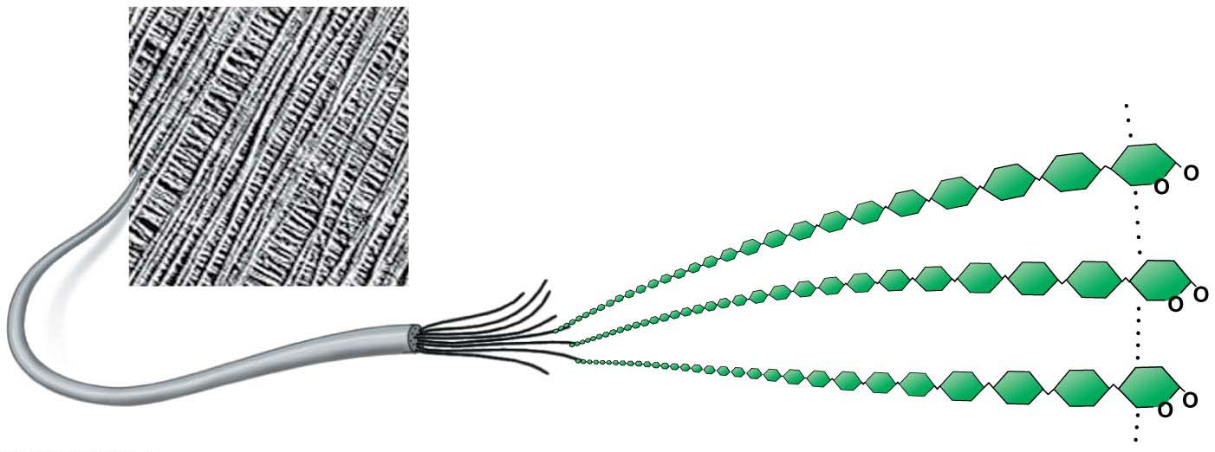
Cellulose섬유소
is the most abundant organic compound on Earth,
forms cable-like fibrils in the walls that enclose plant cells, and
cannot be broken by any enzyme produced by animals.
Cellulose microfibrils
in a plant cell wall
Cellulose molecules
Notes:
16
Student Misconceptions and Concerns
1. The abstract nature of chemistry can be discouraging to many students. Consider starting out this section of the lecture by examining the chemical groups on a food nutrition label. Candy bars with peanuts are particularly useful as they contain significant amounts of all three sources of calories (carbohydrates, proteins, and lipids).
2. Students might struggle to extrapolate the properties of lipids to their roles in an organism. Ducks float because their feathers repel water instead of attracting it. Hair on your head remains flexible because of oils produced in your scalp. Examples such as these help connect the abstract properties of lipids to concrete examples in our world.
3. The functional significance of protein shape is an abstract molecular example of form and function relationships, which might be new to some students. The binding of an enzyme to its substrate is a type of molecular handshake, which permits specific interactions. To help students think about form and function relationships, share some concrete analogies in their lives—perhaps flathead and Phillips screwdrivers that match the proper type of screws or the fit of a hand into a glove.
4. The evolution of lactose tolerance within human groups in East Africa does not represent a deliberate decision, yet this evolutionary change appears logical. Many students perceive adaptations as deliberate events with purpose. As students develop a better understanding of the mechanisms of evolution, it will be important to point out that mutations arise by chance, with the culling hand of natural selection favoring traits that convey an advantage. Organisms cannot plan evolutionary change.
Teaching Tips
1. Consider reinforcing the three main sources of calories with food items that clearly represent each group. Bring clear examples to class as visual references, for example, a can of Coke or a bag of sugar for carbohydrates, a tub of margarine for lipids, and some beef jerky for protein (although some fat and carbohydrates might also be included).
2. If your lectures will eventually include details of glycolysis and aerobic respiration, this is a good point to introduce the basic concepts of glucose as fuel. Just introducing this conceptual formula might help: eating glucose + breathing in oxygen (yields) water + usable energy (used to build ATP) + heat + exhaled CO₂.
3. The section about our use of sugars may be of considerable interest to your students, who might not be expecting much interest in a lecture about organic chemistry. Consider an assignment for each student to bring to class a product label indicating high-fructose corn syrup (HFCS) as an ingredient.
4. Learning the definitions of word roots is invaluable when learning science. Learning the meaning of the prefix word roots “mono” (one), “di” (two), and “poly” (many) helps to distinguish the structures of various carbohydrates.
5. Consider an assignment for students to find reliable sources that discuss high sugar consumption in the modern diet. The key, of course, is in the quality of the resource. Consider narrowing down the categories to certain nonprofit health organizations (American Cancer Society, American Heart Association, and the like) and peer-reviewed journals.
6. A simple exercise demonstrates the enzymatic breakdown of starches into sugars. If students place an unsalted cracker in their mouths, holding it in their mouths while it mixes well with saliva, they might soon notice that a sweeter taste begins to emerge. The salivary enzyme amylase begins the digestion of starches into disaccharides, which may be degraded further by other enzymes. These disaccharides are the source of the sweet taste.
7. An adult human may store about a half of a kilogram of glycogen in the liver and muscles of the body, depending on recent dietary habits. A person who begins dieting might soon notice an immediate weight loss of 2–4 pounds (1–2 kilograms) over several days, reflecting reductions in stored glycogen, water, and intestinal contents (among other factors).
8. Another simple demonstration can illustrate hydrophobic and hydrophilic substances. In front of the class, mix colored water and a yellow oil (corn or canola oil work well). Shake up the mixture and then watch as the two separate. (You may have a mixture already made that remains separated; however, the dyes may bleed between the oil and the water.)
9. Margarine in stores commonly comes in liquid squeeze containers, in tubs, and in sticks. These forms reflect increasing amounts of hydrogenation, gradually increasing the stiffness from a liquid, to a firmer spread, to a firm stick of margarine. As noted in the text, recent studies have suggested that unsaturated oils become increasingly unhealthy as they are hydrogenated. Perhaps your students can find references to this correlation on the Internet.
10. Many analogies can help students understand the diversity of proteins that can be made from just 20 amino acids. The authors note that our language uses combinations of 26 letters to form words. Proteins are much longer “words,” creating even more diversity. Another analogy is to trains. This builds on the earlier analogy when polymers were introduced. Imagine making different trains about 100 cars long, using any combination of 20 types of railroad cars. Mathematically, the number of possible trains is 20¹⁰⁰, a number beyond imagination.
11. The authors note that the difference between a polypeptide and a protein is analogous to the relationship between a long strand of yarn and a sweater knitted from yarn. Proteins are clearly more complex!
12. Most cooking results in changes in the texture and color of a food. The brown color of a steak is the product of the denaturation of proteins. Fixatives such as formalin also denature proteins and cause color changes. Students who have dissected vertebrates will realize that the brown color of the muscles makes it look as if the animal has been cooked.
13. The “NA” in DNA and RNA stands for “nucleic acid.” Students often do not make this association without assistance.
Active Lecture Tips
1. The cellophane wrap often used to package foods is a biodegradable material derived from cellulose. Challenge students to work in pairs to create a list of other cellulose-derived products (such as paper).
2. Consider this assignment to finish a discussion of the diverse organic molecules in our diets. Have students work in pairs or small groups to analyze a food label listing the components of a McDonald’s Big Mac. Note the most abundant organic molecule class (perhaps by weight) found in each component.
3. See the Activity What Ingredients Make Up Your Snack Food on the Instructor Exchange. Visit the Instructor Exchange in the MasteringBiology instructor resource area for a description of this activity.
4. See the Activity Drawing Hydrophobic and Hydrophilic Interactions on the Instructor Exchange. Visit the Instructor Exchange in the MasteringBiology instructor resource area for a description of this activity.

Slide 17
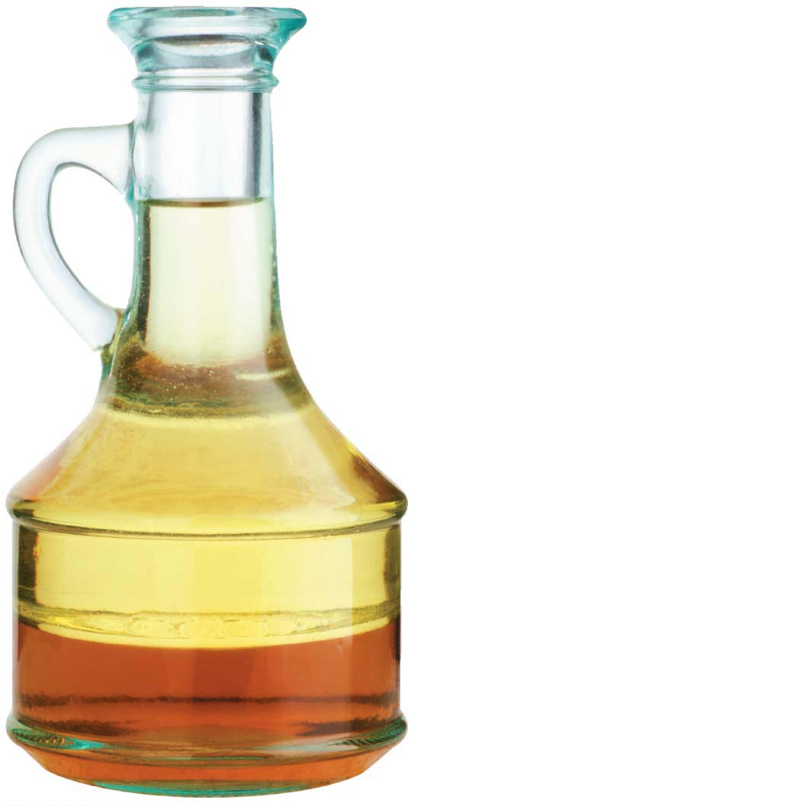
Lipids지질
Almost all carbohydrates are hydrophilic (“water-loving”) molecules that dissolve readily in water.
Lipids are hydrophobic and diverse group of molecules made from different molecular building blocks that are unable to mix with water.
Lipids also differ from carbohydrates, proteins, and nucleic acids in that they are neither huge macromolecules nor are they necessarily polymers built from repeating monomers.
Oil (hydrophobic)
Vinegar (hydrophilic)
Notes:
17
Student Misconceptions and Concerns
1. The abstract nature of chemistry can be discouraging to many students. Consider starting out this section of the lecture by examining the chemical groups on a food nutrition label. Candy bars with peanuts are particularly useful as they contain significant amounts of all three sources of calories (carbohydrates, proteins, and lipids).
2. Students might struggle to extrapolate the properties of lipids to their roles in an organism. Ducks float because their feathers repel water instead of attracting it. Hair on your head remains flexible because of oils produced in your scalp. Examples such as these help connect the abstract properties of lipids to concrete examples in our world.
3. The functional significance of protein shape is an abstract molecular example of form and function relationships, which might be new to some students. The binding of an enzyme to its substrate is a type of molecular handshake, which permits specific interactions. To help students think about form and function relationships, share some concrete analogies in their lives—perhaps flathead and Phillips screwdrivers that match the proper type of screws or the fit of a hand into a glove.
4. The evolution of lactose tolerance within human groups in East Africa does not represent a deliberate decision, yet this evolutionary change appears logical. Many students perceive adaptations as deliberate events with purpose. As students develop a better understanding of the mechanisms of evolution, it will be important to point out that mutations arise by chance, with the culling hand of natural selection favoring traits that convey an advantage. Organisms cannot plan evolutionary change.
Teaching Tips
1. Consider reinforcing the three main sources of calories with food items that clearly represent each group. Bring clear examples to class as visual references, for example, a can of Coke or a bag of sugar for carbohydrates, a tub of margarine for lipids, and some beef jerky for protein (although some fat and carbohydrates might also be included).
2. If your lectures will eventually include details of glycolysis and aerobic respiration, this is a good point to introduce the basic concepts of glucose as fuel. Just introducing this conceptual formula might help: eating glucose + breathing in oxygen (yields) water + usable energy (used to build ATP) + heat + exhaled CO₂.
3. The section about our use of sugars may be of considerable interest to your students, who might not be expecting much interest in a lecture about organic chemistry. Consider an assignment for each student to bring to class a product label indicating high-fructose corn syrup (HFCS) as an ingredient.
4. Learning the definitions of word roots is invaluable when learning science. Learning the meaning of the prefix word roots “mono” (one), “di” (two), and “poly” (many) helps to distinguish the structures of various carbohydrates.
5. Consider an assignment for students to find reliable sources that discuss high sugar consumption in the modern diet. The key, of course, is in the quality of the resource. Consider narrowing down the categories to certain nonprofit health organizations (American Cancer Society, American Heart Association, and the like) and peer-reviewed journals.
6. A simple exercise demonstrates the enzymatic breakdown of starches into sugars. If students place an unsalted cracker in their mouths, holding it in their mouths while it mixes well with saliva, they might soon notice that a sweeter taste begins to emerge. The salivary enzyme amylase begins the digestion of starches into disaccharides, which may be degraded further by other enzymes. These disaccharides are the source of the sweet taste.
7. An adult human may store about a half of a kilogram of glycogen in the liver and muscles of the body, depending on recent dietary habits. A person who begins dieting might soon notice an immediate weight loss of 2–4 pounds (1–2 kilograms) over several days, reflecting reductions in stored glycogen, water, and intestinal contents (among other factors).
8. Another simple demonstration can illustrate hydrophobic and hydrophilic substances. In front of the class, mix colored water and a yellow oil (corn or canola oil work well). Shake up the mixture and then watch as the two separate. (You may have a mixture already made that remains separated; however, the dyes may bleed between the oil and the water.)
9. Margarine in stores commonly comes in liquid squeeze containers, in tubs, and in sticks. These forms reflect increasing amounts of hydrogenation, gradually increasing the stiffness from a liquid, to a firmer spread, to a firm stick of margarine. As noted in the text, recent studies have suggested that unsaturated oils become increasingly unhealthy as they are hydrogenated. Perhaps your students can find references to this correlation on the Internet.
10. Many analogies can help students understand the diversity of proteins that can be made from just 20 amino acids. The authors note that our language uses combinations of 26 letters to form words. Proteins are much longer “words,” creating even more diversity. Another analogy is to trains. This builds on the earlier analogy when polymers were introduced. Imagine making different trains about 100 cars long, using any combination of 20 types of railroad cars. Mathematically, the number of possible trains is 20¹⁰⁰, a number beyond imagination.
11. The authors note that the difference between a polypeptide and a protein is analogous to the relationship between a long strand of yarn and a sweater knitted from yarn. Proteins are clearly more complex!
12. Most cooking results in changes in the texture and color of a food. The brown color of a steak is the product of the denaturation of proteins. Fixatives such as formalin also denature proteins and cause color changes. Students who have dissected vertebrates will realize that the brown color of the muscles makes it look as if the animal has been cooked.
13. The “NA” in DNA and RNA stands for “nucleic acid.” Students often do not make this association without assistance.
Active Lecture Tips
1. The cellophane wrap often used to package foods is a biodegradable material derived from cellulose. Challenge students to work in pairs to create a list of other cellulose-derived products (such as paper).
2. Consider this assignment to finish a discussion of the diverse organic molecules in our diets. Have students work in pairs or small groups to analyze a food label listing the components of a McDonald’s Big Mac. Note the most abundant organic molecule class (perhaps by weight) found in each component.
3. See the Activity What Ingredients Make Up Your Snack Food on the Instructor Exchange. Visit the Instructor Exchange in the MasteringBiology instructor resource area for a description of this activity.
4. See the Activity Drawing Hydrophobic and Hydrophilic Interactions on the Instructor Exchange. Visit the Instructor Exchange in the MasteringBiology instructor resource area for a description of this activity.

Slide 18
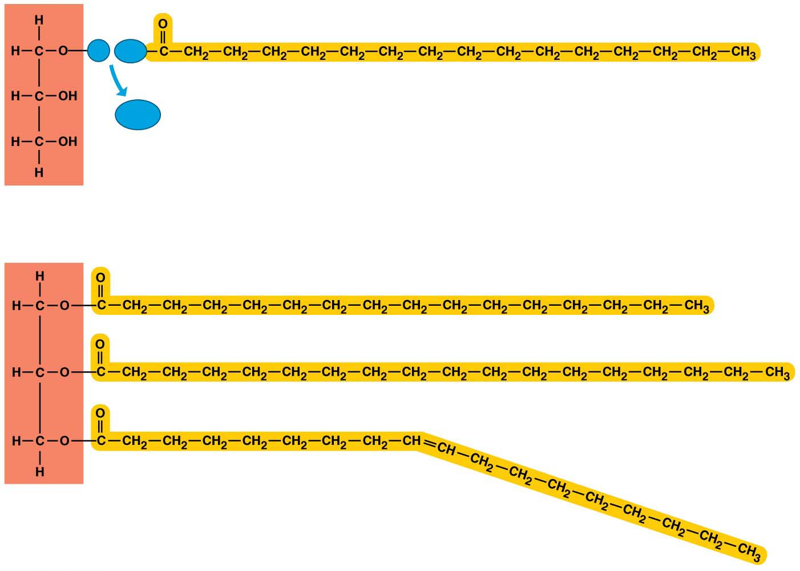
Fats
A typical fat지방, or triglyceride, consists of a glycerol molecule joined with three fatty acid molecules via a dehydration reaction.
Glycerol
Fatty acid 지방산
(a) A dehydration reaction linking a fatty acid to glycerol
(b) A fat molecule with a glycerol “head” and three
energy-rich hydrocarbon fatty acid “tails”
Notes:
18
Student Misconceptions and Concerns
1. The abstract nature of chemistry can be discouraging to many students. Consider starting out this section of the lecture by examining the chemical groups on a food nutrition label. Candy bars with peanuts are particularly useful as they contain significant amounts of all three sources of calories (carbohydrates, proteins, and lipids).
2. Students might struggle to extrapolate the properties of lipids to their roles in an organism. Ducks float because their feathers repel water instead of attracting it. Hair on your head remains flexible because of oils produced in your scalp. Examples such as these help connect the abstract properties of lipids to concrete examples in our world.
3. The functional significance of protein shape is an abstract molecular example of form and function relationships, which might be new to some students. The binding of an enzyme to its substrate is a type of molecular handshake, which permits specific interactions. To help students think about form and function relationships, share some concrete analogies in their lives—perhaps flathead and Phillips screwdrivers that match the proper type of screws or the fit of a hand into a glove.
4. The evolution of lactose tolerance within human groups in East Africa does not represent a deliberate decision, yet this evolutionary change appears logical. Many students perceive adaptations as deliberate events with purpose. As students develop a better understanding of the mechanisms of evolution, it will be important to point out that mutations arise by chance, with the culling hand of natural selection favoring traits that convey an advantage. Organisms cannot plan evolutionary change.
Teaching Tips
1. Consider reinforcing the three main sources of calories with food items that clearly represent each group. Bring clear examples to class as visual references, for example, a can of Coke or a bag of sugar for carbohydrates, a tub of margarine for lipids, and some beef jerky for protein (although some fat and carbohydrates might also be included).
2. If your lectures will eventually include details of glycolysis and aerobic respiration, this is a good point to introduce the basic concepts of glucose as fuel. Just introducing this conceptual formula might help: eating glucose + breathing in oxygen (yields) water + usable energy (used to build ATP) + heat + exhaled CO₂.
3. The section about our use of sugars may be of considerable interest to your students, who might not be expecting much interest in a lecture about organic chemistry. Consider an assignment for each student to bring to class a product label indicating high-fructose corn syrup (HFCS) as an ingredient.
4. Learning the definitions of word roots is invaluable when learning science. Learning the meaning of the prefix word roots “mono” (one), “di” (two), and “poly” (many) helps to distinguish the structures of various carbohydrates.
5. Consider an assignment for students to find reliable sources that discuss high sugar consumption in the modern diet. The key, of course, is in the quality of the resource. Consider narrowing down the categories to certain nonprofit health organizations (American Cancer Society, American Heart Association, and the like) and peer-reviewed journals.
6. A simple exercise demonstrates the enzymatic breakdown of starches into sugars. If students place an unsalted cracker in their mouths, holding it in their mouths while it mixes well with saliva, they might soon notice that a sweeter taste begins to emerge. The salivary enzyme amylase begins the digestion of starches into disaccharides, which may be degraded further by other enzymes. These disaccharides are the source of the sweet taste.
7. An adult human may store about a half of a kilogram of glycogen in the liver and muscles of the body, depending on recent dietary habits. A person who begins dieting might soon notice an immediate weight loss of 2–4 pounds (1–2 kilograms) over several days, reflecting reductions in stored glycogen, water, and intestinal contents (among other factors).
8. Another simple demonstration can illustrate hydrophobic and hydrophilic substances. In front of the class, mix colored water and a yellow oil (corn or canola oil work well). Shake up the mixture and then watch as the two separate. (You may have a mixture already made that remains separated; however, the dyes may bleed between the oil and the water.)
9. Margarine in stores commonly comes in liquid squeeze containers, in tubs, and in sticks. These forms reflect increasing amounts of hydrogenation, gradually increasing the stiffness from a liquid, to a firmer spread, to a firm stick of margarine. As noted in the text, recent studies have suggested that unsaturated oils become increasingly unhealthy as they are hydrogenated. Perhaps your students can find references to this correlation on the Internet.
10. Many analogies can help students understand the diversity of proteins that can be made from just 20 amino acids. The authors note that our language uses combinations of 26 letters to form words. Proteins are much longer “words,” creating even more diversity. Another analogy is to trains. This builds on the earlier analogy when polymers were introduced. Imagine making different trains about 100 cars long, using any combination of 20 types of railroad cars. Mathematically, the number of possible trains is 20¹⁰⁰, a number beyond imagination.
11. The authors note that the difference between a polypeptide and a protein is analogous to the relationship between a long strand of yarn and a sweater knitted from yarn. Proteins are clearly more complex!
12. Most cooking results in changes in the texture and color of a food. The brown color of a steak is the product of the denaturation of proteins. Fixatives such as formalin also denature proteins and cause color changes. Students who have dissected vertebrates will realize that the brown color of the muscles makes it look as if the animal has been cooked.
13. The “NA” in DNA and RNA stands for “nucleic acid.” Students often do not make this association without assistance.
Active Lecture Tips
1. The cellophane wrap often used to package foods is a biodegradable material derived from cellulose. Challenge students to work in pairs to create a list of other cellulose-derived products (such as paper).
2. Consider this assignment to finish a discussion of the diverse organic molecules in our diets. Have students work in pairs or small groups to analyze a food label listing the components of a McDonald’s Big Mac. Note the most abundant organic molecule class (perhaps by weight) found in each component.
3. See the Activity What Ingredients Make Up Your Snack Food on the Instructor Exchange. Visit the Instructor Exchange in the MasteringBiology instructor resource area for a description of this activity.
4. See the Activity Drawing Hydrophobic and Hydrophilic Interactions on the Instructor Exchange. Visit the Instructor Exchange in the MasteringBiology instructor resource area for a description of this activity.

Slide 19
Fats perform essential functions in the human body including
energy storage, cushioning, and insulation.
If the carbon skeleton of a fatty acid has fewer than the maximum number of hydrogens at the double bond, it is unsaturated불포화.
If it has the maximum number of hydrogens, it is saturated포화.
A saturated fat has all three of its fatty acids saturated.
Most animal fats
have a relatively high proportion of saturated fatty acids,
can easily stack, tending to be solid at room temperature, and
contribute to atherosclerosis죽상동맥경화, in which lipid-containing plaques build up along the inside walls of blood vessels.
Notes:
19
Student Misconceptions and Concerns
1. The abstract nature of chemistry can be discouraging to many students. Consider starting out this section of the lecture by examining the chemical groups on a food nutrition label. Candy bars with peanuts are particularly useful as they contain significant amounts of all three sources of calories (carbohydrates, proteins, and lipids).
2. Students might struggle to extrapolate the properties of lipids to their roles in an organism. Ducks float because their feathers repel water instead of attracting it. Hair on your head remains flexible because of oils produced in your scalp. Examples such as these help connect the abstract properties of lipids to concrete examples in our world.
3. The functional significance of protein shape is an abstract molecular example of form and function relationships, which might be new to some students. The binding of an enzyme to its substrate is a type of molecular handshake, which permits specific interactions. To help students think about form and function relationships, share some concrete analogies in their lives—perhaps flathead and Phillips screwdrivers that match the proper type of screws or the fit of a hand into a glove.
4. The evolution of lactose tolerance within human groups in East Africa does not represent a deliberate decision, yet this evolutionary change appears logical. Many students perceive adaptations as deliberate events with purpose. As students develop a better understanding of the mechanisms of evolution, it will be important to point out that mutations arise by chance, with the culling hand of natural selection favoring traits that convey an advantage. Organisms cannot plan evolutionary change.
Teaching Tips
1. Consider reinforcing the three main sources of calories with food items that clearly represent each group. Bring clear examples to class as visual references, for example, a can of Coke or a bag of sugar for carbohydrates, a tub of margarine for lipids, and some beef jerky for protein (although some fat and carbohydrates might also be included).
2. If your lectures will eventually include details of glycolysis and aerobic respiration, this is a good point to introduce the basic concepts of glucose as fuel. Just introducing this conceptual formula might help: eating glucose + breathing in oxygen (yields) water + usable energy (used to build ATP) + heat + exhaled CO₂.
3. The section about our use of sugars may be of considerable interest to your students, who might not be expecting much interest in a lecture about organic chemistry. Consider an assignment for each student to bring to class a product label indicating high-fructose corn syrup (HFCS) as an ingredient.
4. Learning the definitions of word roots is invaluable when learning science. Learning the meaning of the prefix word roots “mono” (one), “di” (two), and “poly” (many) helps to distinguish the structures of various carbohydrates.
5. Consider an assignment for students to find reliable sources that discuss high sugar consumption in the modern diet. The key, of course, is in the quality of the resource. Consider narrowing down the categories to certain nonprofit health organizations (American Cancer Society, American Heart Association, and the like) and peer-reviewed journals.
6. A simple exercise demonstrates the enzymatic breakdown of starches into sugars. If students place an unsalted cracker in their mouths, holding it in their mouths while it mixes well with saliva, they might soon notice that a sweeter taste begins to emerge. The salivary enzyme amylase begins the digestion of starches into disaccharides, which may be degraded further by other enzymes. These disaccharides are the source of the sweet taste.
7. An adult human may store about a half of a kilogram of glycogen in the liver and muscles of the body, depending on recent dietary habits. A person who begins dieting might soon notice an immediate weight loss of 2–4 pounds (1–2 kilograms) over several days, reflecting reductions in stored glycogen, water, and intestinal contents (among other factors).
8. Another simple demonstration can illustrate hydrophobic and hydrophilic substances. In front of the class, mix colored water and a yellow oil (corn or canola oil work well). Shake up the mixture and then watch as the two separate. (You may have a mixture already made that remains separated; however, the dyes may bleed between the oil and the water.)
9. Margarine in stores commonly comes in liquid squeeze containers, in tubs, and in sticks. These forms reflect increasing amounts of hydrogenation, gradually increasing the stiffness from a liquid, to a firmer spread, to a firm stick of margarine. As noted in the text, recent studies have suggested that unsaturated oils become increasingly unhealthy as they are hydrogenated. Perhaps your students can find references to this correlation on the Internet.
10. Many analogies can help students understand the diversity of proteins that can be made from just 20 amino acids. The authors note that our language uses combinations of 26 letters to form words. Proteins are much longer “words,” creating even more diversity. Another analogy is to trains. This builds on the earlier analogy when polymers were introduced. Imagine making different trains about 100 cars long, using any combination of 20 types of railroad cars. Mathematically, the number of possible trains is 20¹⁰⁰, a number beyond imagination.
11. The authors note that the difference between a polypeptide and a protein is analogous to the relationship between a long strand of yarn and a sweater knitted from yarn. Proteins are clearly more complex!
12. Most cooking results in changes in the texture and color of a food. The brown color of a steak is the product of the denaturation of proteins. Fixatives such as formalin also denature proteins and cause color changes. Students who have dissected vertebrates will realize that the brown color of the muscles makes it look as if the animal has been cooked.
13. The “NA” in DNA and RNA stands for “nucleic acid.” Students often do not make this association without assistance.
Active Lecture Tips
1. The cellophane wrap often used to package foods is a biodegradable material derived from cellulose. Challenge students to work in pairs to create a list of other cellulose-derived products (such as paper).
2. Consider this assignment to finish a discussion of the diverse organic molecules in our diets. Have students work in pairs or small groups to analyze a food label listing the components of a McDonald’s Big Mac. Note the most abundant organic molecule class (perhaps by weight) found in each component.
3. See the Activity What Ingredients Make Up Your Snack Food on the Instructor Exchange. Visit the Instructor Exchange in the MasteringBiology instructor resource area for a description of this activity.
4. See the Activity Drawing Hydrophobic and Hydrophilic Interactions on the Instructor Exchange. Visit the Instructor Exchange in the MasteringBiology instructor resource area for a description of this activity.

Slide 20
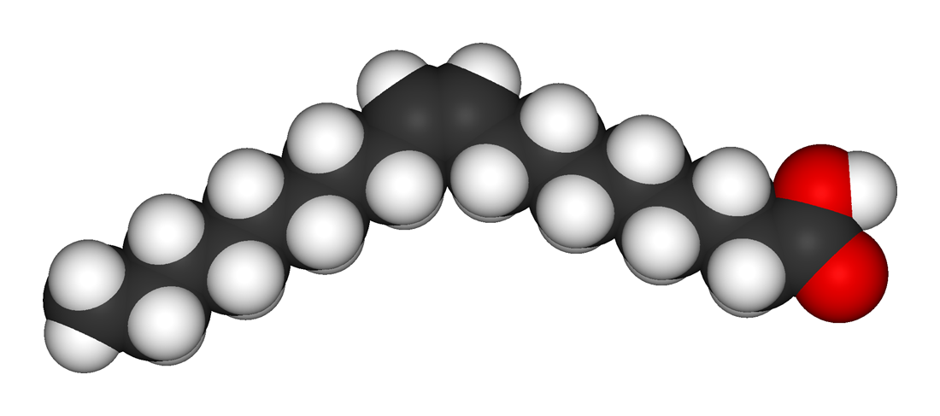
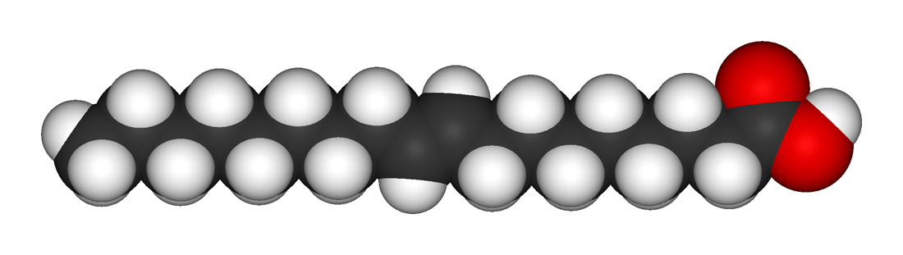
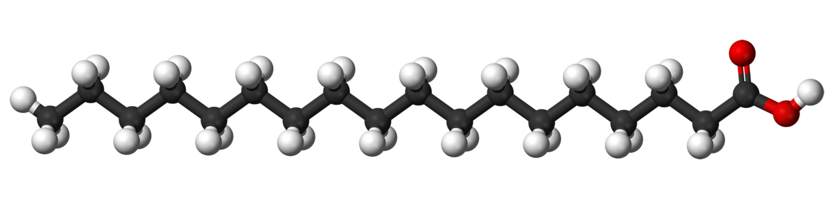
Most plant and fish fats tend to be
high in unsaturated fatty acids and
liquid at room temperature.
Hydrogenation수소화
adds hydrogen,
converts unsaturated fats to saturated fats,
makes liquid fats solid at room temperature, and
creates trans fats, a type of unsaturated fat that is particularly bad for your health.
Cis (Oleic acid)
Trans (Elaidic acid)
Saturated (Stearic acid)
Notes:
20
Student Misconceptions and Concerns
1. The abstract nature of chemistry can be discouraging to many students. Consider starting out this section of the lecture by examining the chemical groups on a food nutrition label. Candy bars with peanuts are particularly useful as they contain significant amounts of all three sources of calories (carbohydrates, proteins, and lipids).
2. Students might struggle to extrapolate the properties of lipids to their roles in an organism. Ducks float because their feathers repel water instead of attracting it. Hair on your head remains flexible because of oils produced in your scalp. Examples such as these help connect the abstract properties of lipids to concrete examples in our world.
3. The functional significance of protein shape is an abstract molecular example of form and function relationships, which might be new to some students. The binding of an enzyme to its substrate is a type of molecular handshake, which permits specific interactions. To help students think about form and function relationships, share some concrete analogies in their lives—perhaps flathead and Phillips screwdrivers that match the proper type of screws or the fit of a hand into a glove.
4. The evolution of lactose tolerance within human groups in East Africa does not represent a deliberate decision, yet this evolutionary change appears logical. Many students perceive adaptations as deliberate events with purpose. As students develop a better understanding of the mechanisms of evolution, it will be important to point out that mutations arise by chance, with the culling hand of natural selection favoring traits that convey an advantage. Organisms cannot plan evolutionary change.
Teaching Tips
1. Consider reinforcing the three main sources of calories with food items that clearly represent each group. Bring clear examples to class as visual references, for example, a can of Coke or a bag of sugar for carbohydrates, a tub of margarine for lipids, and some beef jerky for protein (although some fat and carbohydrates might also be included).
2. If your lectures will eventually include details of glycolysis and aerobic respiration, this is a good point to introduce the basic concepts of glucose as fuel. Just introducing this conceptual formula might help: eating glucose + breathing in oxygen (yields) water + usable energy (used to build ATP) + heat + exhaled CO₂.
3. The section about our use of sugars may be of considerable interest to your students, who might not be expecting much interest in a lecture about organic chemistry. Consider an assignment for each student to bring to class a product label indicating high-fructose corn syrup (HFCS) as an ingredient.
4. Learning the definitions of word roots is invaluable when learning science. Learning the meaning of the prefix word roots “mono” (one), “di” (two), and “poly” (many) helps to distinguish the structures of various carbohydrates.
5. Consider an assignment for students to find reliable sources that discuss high sugar consumption in the modern diet. The key, of course, is in the quality of the resource. Consider narrowing down the categories to certain nonprofit health organizations (American Cancer Society, American Heart Association, and the like) and peer-reviewed journals.
6. A simple exercise demonstrates the enzymatic breakdown of starches into sugars. If students place an unsalted cracker in their mouths, holding it in their mouths while it mixes well with saliva, they might soon notice that a sweeter taste begins to emerge. The salivary enzyme amylase begins the digestion of starches into disaccharides, which may be degraded further by other enzymes. These disaccharides are the source of the sweet taste.
7. An adult human may store about a half of a kilogram of glycogen in the liver and muscles of the body, depending on recent dietary habits. A person who begins dieting might soon notice an immediate weight loss of 2–4 pounds (1–2 kilograms) over several days, reflecting reductions in stored glycogen, water, and intestinal contents (among other factors).
8. Another simple demonstration can illustrate hydrophobic and hydrophilic substances. In front of the class, mix colored water and a yellow oil (corn or canola oil work well). Shake up the mixture and then watch as the two separate. (You may have a mixture already made that remains separated; however, the dyes may bleed between the oil and the water.)
9. Margarine in stores commonly comes in liquid squeeze containers, in tubs, and in sticks. These forms reflect increasing amounts of hydrogenation, gradually increasing the stiffness from a liquid, to a firmer spread, to a firm stick of margarine. As noted in the text, recent studies have suggested that unsaturated oils become increasingly unhealthy as they are hydrogenated. Perhaps your students can find references to this correlation on the Internet.
10. Many analogies can help students understand the diversity of proteins that can be made from just 20 amino acids. The authors note that our language uses combinations of 26 letters to form words. Proteins are much longer “words,” creating even more diversity. Another analogy is to trains. This builds on the earlier analogy when polymers were introduced. Imagine making different trains about 100 cars long, using any combination of 20 types of railroad cars. Mathematically, the number of possible trains is 20¹⁰⁰, a number beyond imagination.
11. The authors note that the difference between a polypeptide and a protein is analogous to the relationship between a long strand of yarn and a sweater knitted from yarn. Proteins are clearly more complex!
12. Most cooking results in changes in the texture and color of a food. The brown color of a steak is the product of the denaturation of proteins. Fixatives such as formalin also denature proteins and cause color changes. Students who have dissected vertebrates will realize that the brown color of the muscles makes it look as if the animal has been cooked.
13. The “NA” in DNA and RNA stands for “nucleic acid.” Students often do not make this association without assistance.
Active Lecture Tips
1. The cellophane wrap often used to package foods is a biodegradable material derived from cellulose. Challenge students to work in pairs to create a list of other cellulose-derived products (such as paper).
2. Consider this assignment to finish a discussion of the diverse organic molecules in our diets. Have students work in pairs or small groups to analyze a food label listing the components of a McDonald’s Big Mac. Note the most abundant organic molecule class (perhaps by weight) found in each component.
3. See the Activity What Ingredients Make Up Your Snack Food on the Instructor Exchange. Visit the Instructor Exchange in the MasteringBiology instructor resource area for a description of this activity.
4. See the Activity Drawing Hydrophobic and Hydrophilic Interactions on the Instructor Exchange. Visit the Instructor Exchange in the MasteringBiology instructor resource area for a description of this activity.

Slide 21
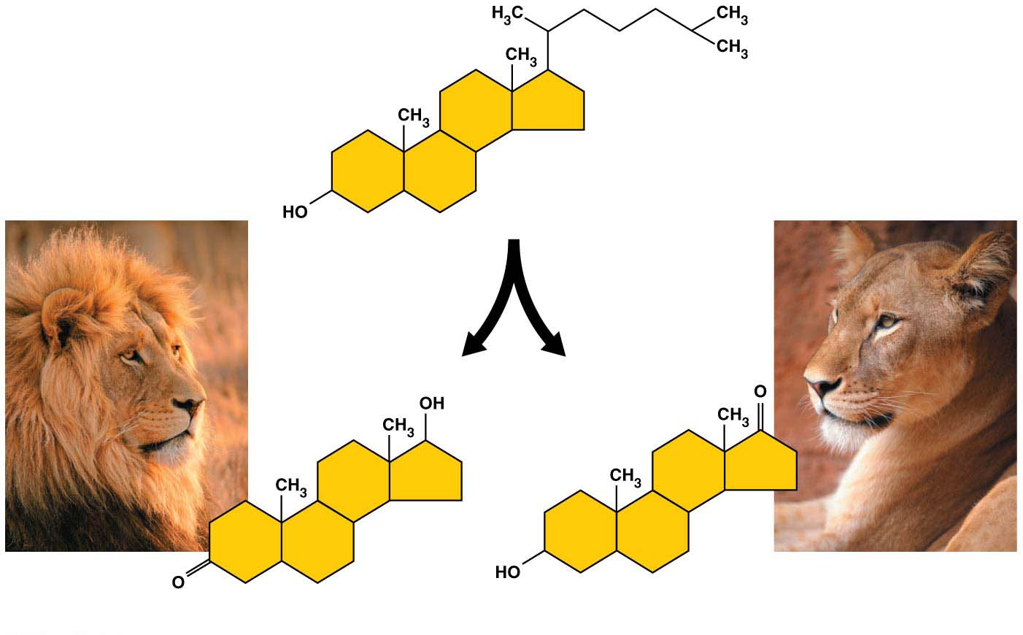
Steroids
Steroids are very different from fats in structure and function.
The carbon skeleton has four fused rings.
Steroids vary in the functional groups attached to this set of rings, and these chemical variations affect their function.
Cholesterol is
a key component of cell membranes and
the “base steroid” from which your body produces other steroids, such as estrogen and testosterone.
Cholesterol
Testosterone
Estrogen
Notes:
21
Student Misconceptions and Concerns
1. The abstract nature of chemistry can be discouraging to many students. Consider starting out this section of the lecture by examining the chemical groups on a food nutrition label. Candy bars with peanuts are particularly useful as they contain significant amounts of all three sources of calories (carbohydrates, proteins, and lipids).
2. Students might struggle to extrapolate the properties of lipids to their roles in an organism. Ducks float because their feathers repel water instead of attracting it. Hair on your head remains flexible because of oils produced in your scalp. Examples such as these help connect the abstract properties of lipids to concrete examples in our world.
3. The functional significance of protein shape is an abstract molecular example of form and function relationships, which might be new to some students. The binding of an enzyme to its substrate is a type of molecular handshake, which permits specific interactions. To help students think about form and function relationships, share some concrete analogies in their lives—perhaps flathead and Phillips screwdrivers that match the proper type of screws or the fit of a hand into a glove.
4. The evolution of lactose tolerance within human groups in East Africa does not represent a deliberate decision, yet this evolutionary change appears logical. Many students perceive adaptations as deliberate events with purpose. As students develop a better understanding of the mechanisms of evolution, it will be important to point out that mutations arise by chance, with the culling hand of natural selection favoring traits that convey an advantage. Organisms cannot plan evolutionary change.
Teaching Tips
1. Consider reinforcing the three main sources of calories with food items that clearly represent each group. Bring clear examples to class as visual references, for example, a can of Coke or a bag of sugar for carbohydrates, a tub of margarine for lipids, and some beef jerky for protein (although some fat and carbohydrates might also be included).
2. If your lectures will eventually include details of glycolysis and aerobic respiration, this is a good point to introduce the basic concepts of glucose as fuel. Just introducing this conceptual formula might help: eating glucose + breathing in oxygen (yields) water + usable energy (used to build ATP) + heat + exhaled CO₂.
3. The section about our use of sugars may be of considerable interest to your students, who might not be expecting much interest in a lecture about organic chemistry. Consider an assignment for each student to bring to class a product label indicating high-fructose corn syrup (HFCS) as an ingredient.
4. Learning the definitions of word roots is invaluable when learning science. Learning the meaning of the prefix word roots “mono” (one), “di” (two), and “poly” (many) helps to distinguish the structures of various carbohydrates.
5. Consider an assignment for students to find reliable sources that discuss high sugar consumption in the modern diet. The key, of course, is in the quality of the resource. Consider narrowing down the categories to certain nonprofit health organizations (American Cancer Society, American Heart Association, and the like) and peer-reviewed journals.
6. A simple exercise demonstrates the enzymatic breakdown of starches into sugars. If students place an unsalted cracker in their mouths, holding it in their mouths while it mixes well with saliva, they might soon notice that a sweeter taste begins to emerge. The salivary enzyme amylase begins the digestion of starches into disaccharides, which may be degraded further by other enzymes. These disaccharides are the source of the sweet taste.
7. An adult human may store about a half of a kilogram of glycogen in the liver and muscles of the body, depending on recent dietary habits. A person who begins dieting might soon notice an immediate weight loss of 2–4 pounds (1–2 kilograms) over several days, reflecting reductions in stored glycogen, water, and intestinal contents (among other factors).
8. Another simple demonstration can illustrate hydrophobic and hydrophilic substances. In front of the class, mix colored water and a yellow oil (corn or canola oil work well). Shake up the mixture and then watch as the two separate. (You may have a mixture already made that remains separated; however, the dyes may bleed between the oil and the water.)
9. Margarine in stores commonly comes in liquid squeeze containers, in tubs, and in sticks. These forms reflect increasing amounts of hydrogenation, gradually increasing the stiffness from a liquid, to a firmer spread, to a firm stick of margarine. As noted in the text, recent studies have suggested that unsaturated oils become increasingly unhealthy as they are hydrogenated. Perhaps your students can find references to this correlation on the Internet.
10. Many analogies can help students understand the diversity of proteins that can be made from just 20 amino acids. The authors note that our language uses combinations of 26 letters to form words. Proteins are much longer “words,” creating even more diversity. Another analogy is to trains. This builds on the earlier analogy when polymers were introduced. Imagine making different trains about 100 cars long, using any combination of 20 types of railroad cars. Mathematically, the number of possible trains is 20¹⁰⁰, a number beyond imagination.
11. The authors note that the difference between a polypeptide and a protein is analogous to the relationship between a long strand of yarn and a sweater knitted from yarn. Proteins are clearly more complex!
12. Most cooking results in changes in the texture and color of a food. The brown color of a steak is the product of the denaturation of proteins. Fixatives such as formalin also denature proteins and cause color changes. Students who have dissected vertebrates will realize that the brown color of the muscles makes it look as if the animal has been cooked.
13. The “NA” in DNA and RNA stands for “nucleic acid.” Students often do not make this association without assistance.
Active Lecture Tips
1. The cellophane wrap often used to package foods is a biodegradable material derived from cellulose. Challenge students to work in pairs to create a list of other cellulose-derived products (such as paper).
2. Consider this assignment to finish a discussion of the diverse organic molecules in our diets. Have students work in pairs or small groups to analyze a food label listing the components of a McDonald’s Big Mac. Note the most abundant organic molecule class (perhaps by weight) found in each component.
3. See the Activity What Ingredients Make Up Your Snack Food on the Instructor Exchange. Visit the Instructor Exchange in the MasteringBiology instructor resource area for a description of this activity.
4. See the Activity Drawing Hydrophobic and Hydrophilic Interactions on the Instructor Exchange. Visit the Instructor Exchange in the MasteringBiology instructor resource area for a description of this activity.

Slide 22
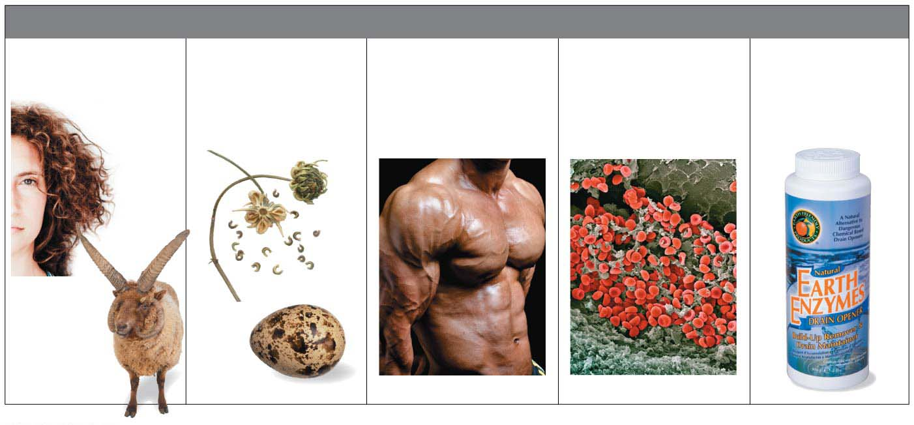
Proteins
Proteins
are polymers of amino acid monomers,
account for more than 50% of the dry weight of most cells, and are instrumental in almost everything cells do.
Storage Proteins
(provide amino
acids for growth)
Contractile
Proteins
(help movement)
Transport Proteins
(help transport
substances)
Enzymes
(help chemical
reactions)
Structural Proteins
(provide support)
Notes:
22
Student Misconceptions and Concerns
1. The abstract nature of chemistry can be discouraging to many students. Consider starting out this section of the lecture by examining the chemical groups on a food nutrition label. Candy bars with peanuts are particularly useful as they contain significant amounts of all three sources of calories (carbohydrates, proteins, and lipids).
2. Students might struggle to extrapolate the properties of lipids to their roles in an organism. Ducks float because their feathers repel water instead of attracting it. Hair on your head remains flexible because of oils produced in your scalp. Examples such as these help connect the abstract properties of lipids to concrete examples in our world.
3. The functional significance of protein shape is an abstract molecular example of form and function relationships, which might be new to some students. The binding of an enzyme to its substrate is a type of molecular handshake, which permits specific interactions. To help students think about form and function relationships, share some concrete analogies in their lives—perhaps flathead and Phillips screwdrivers that match the proper type of screws or the fit of a hand into a glove.
4. The evolution of lactose tolerance within human groups in East Africa does not represent a deliberate decision, yet this evolutionary change appears logical. Many students perceive adaptations as deliberate events with purpose. As students develop a better understanding of the mechanisms of evolution, it will be important to point out that mutations arise by chance, with the culling hand of natural selection favoring traits that convey an advantage. Organisms cannot plan evolutionary change.
Teaching Tips
1. Consider reinforcing the three main sources of calories with food items that clearly represent each group. Bring clear examples to class as visual references, for example, a can of Coke or a bag of sugar for carbohydrates, a tub of margarine for lipids, and some beef jerky for protein (although some fat and carbohydrates might also be included).
2. If your lectures will eventually include details of glycolysis and aerobic respiration, this is a good point to introduce the basic concepts of glucose as fuel. Just introducing this conceptual formula might help: eating glucose + breathing in oxygen (yields) water + usable energy (used to build ATP) + heat + exhaled CO₂.
3. The section about our use of sugars may be of considerable interest to your students, who might not be expecting much interest in a lecture about organic chemistry. Consider an assignment for each student to bring to class a product label indicating high-fructose corn syrup (HFCS) as an ingredient.
4. Learning the definitions of word roots is invaluable when learning science. Learning the meaning of the prefix word roots “mono” (one), “di” (two), and “poly” (many) helps to distinguish the structures of various carbohydrates.
5. Consider an assignment for students to find reliable sources that discuss high sugar consumption in the modern diet. The key, of course, is in the quality of the resource. Consider narrowing down the categories to certain nonprofit health organizations (American Cancer Society, American Heart Association, and the like) and peer-reviewed journals.
6. A simple exercise demonstrates the enzymatic breakdown of starches into sugars. If students place an unsalted cracker in their mouths, holding it in their mouths while it mixes well with saliva, they might soon notice that a sweeter taste begins to emerge. The salivary enzyme amylase begins the digestion of starches into disaccharides, which may be degraded further by other enzymes. These disaccharides are the source of the sweet taste.
7. An adult human may store about a half of a kilogram of glycogen in the liver and muscles of the body, depending on recent dietary habits. A person who begins dieting might soon notice an immediate weight loss of 2–4 pounds (1–2 kilograms) over several days, reflecting reductions in stored glycogen, water, and intestinal contents (among other factors).
8. Another simple demonstration can illustrate hydrophobic and hydrophilic substances. In front of the class, mix colored water and a yellow oil (corn or canola oil work well). Shake up the mixture and then watch as the two separate. (You may have a mixture already made that remains separated; however, the dyes may bleed between the oil and the water.)
9. Margarine in stores commonly comes in liquid squeeze containers, in tubs, and in sticks. These forms reflect increasing amounts of hydrogenation, gradually increasing the stiffness from a liquid, to a firmer spread, to a firm stick of margarine. As noted in the text, recent studies have suggested that unsaturated oils become increasingly unhealthy as they are hydrogenated. Perhaps your students can find references to this correlation on the Internet.
10. Many analogies can help students understand the diversity of proteins that can be made from just 20 amino acids. The authors note that our language uses combinations of 26 letters to form words. Proteins are much longer “words,” creating even more diversity. Another analogy is to trains. This builds on the earlier analogy when polymers were introduced. Imagine making different trains about 100 cars long, using any combination of 20 types of railroad cars. Mathematically, the number of possible trains is 20¹⁰⁰, a number beyond imagination.
11. The authors note that the difference between a polypeptide and a protein is analogous to the relationship between a long strand of yarn and a sweater knitted from yarn. Proteins are clearly more complex!
12. Most cooking results in changes in the texture and color of a food. The brown color of a steak is the product of the denaturation of proteins. Fixatives such as formalin also denature proteins and cause color changes. Students who have dissected vertebrates will realize that the brown color of the muscles makes it look as if the animal has been cooked.
13. The “NA” in DNA and RNA stands for “nucleic acid.” Students often do not make this association without assistance.
Active Lecture Tips
1. The cellophane wrap often used to package foods is a biodegradable material derived from cellulose. Challenge students to work in pairs to create a list of other cellulose-derived products (such as paper).
2. Consider this assignment to finish a discussion of the diverse organic molecules in our diets. Have students work in pairs or small groups to analyze a food label listing the components of a McDonald’s Big Mac. Note the most abundant organic molecule class (perhaps by weight) found in each component.
3. See the Activity What Ingredients Make Up Your Snack Food on the Instructor Exchange. Visit the Instructor Exchange in the MasteringBiology instructor resource area for a description of this activity.
4. See the Activity Drawing Hydrophobic and Hydrophilic Interactions on the Instructor Exchange. Visit the Instructor Exchange in the MasteringBiology instructor resource area for a description of this activity.

Slide 23
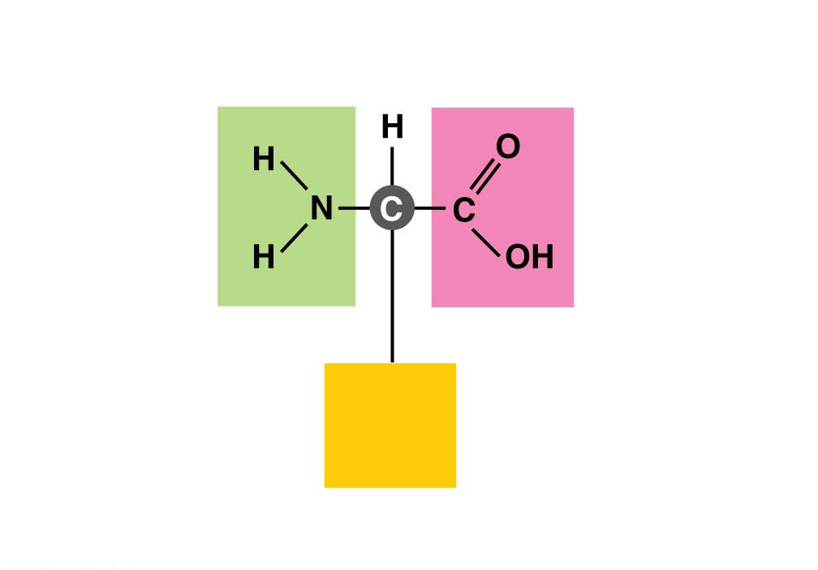
The Monomers of Proteins: Amino Acids
All proteins are made by stringing together a common set of 20 kinds of amino acids.
Every amino acid consists of a central carbon atom bonded to four covalent partners.
Three of those attachment groups are common to all amino acids:
a carboxyl group (−COOH),
an amino group (−NH₂), and
a hydrogen atom.
The variable component of amino acids
is called the side chain and
is attached to the fourth bond of
the central carbon.
Notes:
23
Student Misconceptions and Concerns
1. The abstract nature of chemistry can be discouraging to many students. Consider starting out this section of the lecture by examining the chemical groups on a food nutrition label. Candy bars with peanuts are particularly useful as they contain significant amounts of all three sources of calories (carbohydrates, proteins, and lipids).
2. Students might struggle to extrapolate the properties of lipids to their roles in an organism. Ducks float because their feathers repel water instead of attracting it. Hair on your head remains flexible because of oils produced in your scalp. Examples such as these help connect the abstract properties of lipids to concrete examples in our world.
3. The functional significance of protein shape is an abstract molecular example of form and function relationships, which might be new to some students. The binding of an enzyme to its substrate is a type of molecular handshake, which permits specific interactions. To help students think about form and function relationships, share some concrete analogies in their lives—perhaps flathead and Phillips screwdrivers that match the proper type of screws or the fit of a hand into a glove.
4. The evolution of lactose tolerance within human groups in East Africa does not represent a deliberate decision, yet this evolutionary change appears logical. Many students perceive adaptations as deliberate events with purpose. As students develop a better understanding of the mechanisms of evolution, it will be important to point out that mutations arise by chance, with the culling hand of natural selection favoring traits that convey an advantage. Organisms cannot plan evolutionary change.
Teaching Tips
1. Consider reinforcing the three main sources of calories with food items that clearly represent each group. Bring clear examples to class as visual references, for example, a can of Coke or a bag of sugar for carbohydrates, a tub of margarine for lipids, and some beef jerky for protein (although some fat and carbohydrates might also be included).
2. If your lectures will eventually include details of glycolysis and aerobic respiration, this is a good point to introduce the basic concepts of glucose as fuel. Just introducing this conceptual formula might help: eating glucose + breathing in oxygen (yields) water + usable energy (used to build ATP) + heat + exhaled CO₂.
3. The section about our use of sugars may be of considerable interest to your students, who might not be expecting much interest in a lecture about organic chemistry. Consider an assignment for each student to bring to class a product label indicating high-fructose corn syrup (HFCS) as an ingredient.
4. Learning the definitions of word roots is invaluable when learning science. Learning the meaning of the prefix word roots “mono” (one), “di” (two), and “poly” (many) helps to distinguish the structures of various carbohydrates.
5. Consider an assignment for students to find reliable sources that discuss high sugar consumption in the modern diet. The key, of course, is in the quality of the resource. Consider narrowing down the categories to certain nonprofit health organizations (American Cancer Society, American Heart Association, and the like) and peer-reviewed journals.
6. A simple exercise demonstrates the enzymatic breakdown of starches into sugars. If students place an unsalted cracker in their mouths, holding it in their mouths while it mixes well with saliva, they might soon notice that a sweeter taste begins to emerge. The salivary enzyme amylase begins the digestion of starches into disaccharides, which may be degraded further by other enzymes. These disaccharides are the source of the sweet taste.
7. An adult human may store about a half of a kilogram of glycogen in the liver and muscles of the body, depending on recent dietary habits. A person who begins dieting might soon notice an immediate weight loss of 2–4 pounds (1–2 kilograms) over several days, reflecting reductions in stored glycogen, water, and intestinal contents (among other factors).
8. Another simple demonstration can illustrate hydrophobic and hydrophilic substances. In front of the class, mix colored water and a yellow oil (corn or canola oil work well). Shake up the mixture and then watch as the two separate. (You may have a mixture already made that remains separated; however, the dyes may bleed between the oil and the water.)
9. Margarine in stores commonly comes in liquid squeeze containers, in tubs, and in sticks. These forms reflect increasing amounts of hydrogenation, gradually increasing the stiffness from a liquid, to a firmer spread, to a firm stick of margarine. As noted in the text, recent studies have suggested that unsaturated oils become increasingly unhealthy as they are hydrogenated. Perhaps your students can find references to this correlation on the Internet.
10. Many analogies can help students understand the diversity of proteins that can be made from just 20 amino acids. The authors note that our language uses combinations of 26 letters to form words. Proteins are much longer “words,” creating even more diversity. Another analogy is to trains. This builds on the earlier analogy when polymers were introduced. Imagine making different trains about 100 cars long, using any combination of 20 types of railroad cars. Mathematically, the number of possible trains is 20¹⁰⁰, a number beyond imagination.
11. The authors note that the difference between a polypeptide and a protein is analogous to the relationship between a long strand of yarn and a sweater knitted from yarn. Proteins are clearly more complex!
12. Most cooking results in changes in the texture and color of a food. The brown color of a steak is the product of the denaturation of proteins. Fixatives such as formalin also denature proteins and cause color changes. Students who have dissected vertebrates will realize that the brown color of the muscles makes it look as if the animal has been cooked.
13. The “NA” in DNA and RNA stands for “nucleic acid.” Students often do not make this association without assistance.
Active Lecture Tips
1. The cellophane wrap often used to package foods is a biodegradable material derived from cellulose. Challenge students to work in pairs to create a list of other cellulose-derived products (such as paper).
2. Consider this assignment to finish a discussion of the diverse organic molecules in our diets. Have students work in pairs or small groups to analyze a food label listing the components of a McDonald’s Big Mac. Note the most abundant organic molecule class (perhaps by weight) found in each component.
3. See the Activity What Ingredients Make Up Your Snack Food on the Instructor Exchange. Visit the Instructor Exchange in the MasteringBiology instructor resource area for a description of this activity.
4. See the Activity Drawing Hydrophobic and Hydrophilic Interactions on the Instructor Exchange. Visit the Instructor Exchange in the MasteringBiology instructor resource area for a description of this activity.

Slide 24
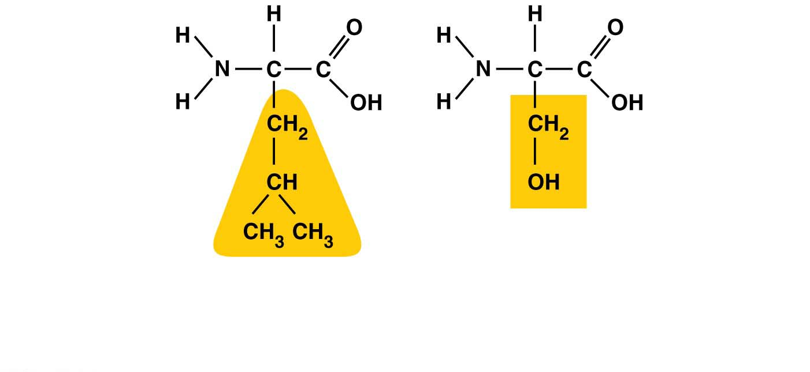
Each type of amino acid has a unique side chain, which gives that amino acid its special chemical properties.
Hydrophilic
side chain
Hydrophobic
side chain
Leucine
Serine
(b) Examples of amino acids with hydrophobic and hydrophilic
side chains
Notes:
24
Student Misconceptions and Concerns
1. The abstract nature of chemistry can be discouraging to many students. Consider starting out this section of the lecture by examining the chemical groups on a food nutrition label. Candy bars with peanuts are particularly useful as they contain significant amounts of all three sources of calories (carbohydrates, proteins, and lipids).
2. Students might struggle to extrapolate the properties of lipids to their roles in an organism. Ducks float because their feathers repel water instead of attracting it. Hair on your head remains flexible because of oils produced in your scalp. Examples such as these help connect the abstract properties of lipids to concrete examples in our world.
3. The functional significance of protein shape is an abstract molecular example of form and function relationships, which might be new to some students. The binding of an enzyme to its substrate is a type of molecular handshake, which permits specific interactions. To help students think about form and function relationships, share some concrete analogies in their lives—perhaps flathead and Phillips screwdrivers that match the proper type of screws or the fit of a hand into a glove.
4. The evolution of lactose tolerance within human groups in East Africa does not represent a deliberate decision, yet this evolutionary change appears logical. Many students perceive adaptations as deliberate events with purpose. As students develop a better understanding of the mechanisms of evolution, it will be important to point out that mutations arise by chance, with the culling hand of natural selection favoring traits that convey an advantage. Organisms cannot plan evolutionary change.
Teaching Tips
1. Consider reinforcing the three main sources of calories with food items that clearly represent each group. Bring clear examples to class as visual references, for example, a can of Coke or a bag of sugar for carbohydrates, a tub of margarine for lipids, and some beef jerky for protein (although some fat and carbohydrates might also be included).
2. If your lectures will eventually include details of glycolysis and aerobic respiration, this is a good point to introduce the basic concepts of glucose as fuel. Just introducing this conceptual formula might help: eating glucose + breathing in oxygen (yields) water + usable energy (used to build ATP) + heat + exhaled CO₂.
3. The section about our use of sugars may be of considerable interest to your students, who might not be expecting much interest in a lecture about organic chemistry. Consider an assignment for each student to bring to class a product label indicating high-fructose corn syrup (HFCS) as an ingredient.
4. Learning the definitions of word roots is invaluable when learning science. Learning the meaning of the prefix word roots “mono” (one), “di” (two), and “poly” (many) helps to distinguish the structures of various carbohydrates.
5. Consider an assignment for students to find reliable sources that discuss high sugar consumption in the modern diet. The key, of course, is in the quality of the resource. Consider narrowing down the categories to certain nonprofit health organizations (American Cancer Society, American Heart Association, and the like) and peer-reviewed journals.
6. A simple exercise demonstrates the enzymatic breakdown of starches into sugars. If students place an unsalted cracker in their mouths, holding it in their mouths while it mixes well with saliva, they might soon notice that a sweeter taste begins to emerge. The salivary enzyme amylase begins the digestion of starches into disaccharides, which may be degraded further by other enzymes. These disaccharides are the source of the sweet taste.
7. An adult human may store about a half of a kilogram of glycogen in the liver and muscles of the body, depending on recent dietary habits. A person who begins dieting might soon notice an immediate weight loss of 2–4 pounds (1–2 kilograms) over several days, reflecting reductions in stored glycogen, water, and intestinal contents (among other factors).
8. Another simple demonstration can illustrate hydrophobic and hydrophilic substances. In front of the class, mix colored water and a yellow oil (corn or canola oil work well). Shake up the mixture and then watch as the two separate. (You may have a mixture already made that remains separated; however, the dyes may bleed between the oil and the water.)
9. Margarine in stores commonly comes in liquid squeeze containers, in tubs, and in sticks. These forms reflect increasing amounts of hydrogenation, gradually increasing the stiffness from a liquid, to a firmer spread, to a firm stick of margarine. As noted in the text, recent studies have suggested that unsaturated oils become increasingly unhealthy as they are hydrogenated. Perhaps your students can find references to this correlation on the Internet.
10. Many analogies can help students understand the diversity of proteins that can be made from just 20 amino acids. The authors note that our language uses combinations of 26 letters to form words. Proteins are much longer “words,” creating even more diversity. Another analogy is to trains. This builds on the earlier analogy when polymers were introduced. Imagine making different trains about 100 cars long, using any combination of 20 types of railroad cars. Mathematically, the number of possible trains is 20¹⁰⁰, a number beyond imagination.
11. The authors note that the difference between a polypeptide and a protein is analogous to the relationship between a long strand of yarn and a sweater knitted from yarn. Proteins are clearly more complex!
12. Most cooking results in changes in the texture and color of a food. The brown color of a steak is the product of the denaturation of proteins. Fixatives such as formalin also denature proteins and cause color changes. Students who have dissected vertebrates will realize that the brown color of the muscles makes it look as if the animal has been cooked.
13. The “NA” in DNA and RNA stands for “nucleic acid.” Students often do not make this association without assistance.
Active Lecture Tips
1. The cellophane wrap often used to package foods is a biodegradable material derived from cellulose. Challenge students to work in pairs to create a list of other cellulose-derived products (such as paper).
2. Consider this assignment to finish a discussion of the diverse organic molecules in our diets. Have students work in pairs or small groups to analyze a food label listing the components of a McDonald’s Big Mac. Note the most abundant organic molecule class (perhaps by weight) found in each component.
3. See the Activity What Ingredients Make Up Your Snack Food on the Instructor Exchange. Visit the Instructor Exchange in the MasteringBiology instructor resource area for a description of this activity.
4. See the Activity Drawing Hydrophobic and Hydrophilic Interactions on the Instructor Exchange. Visit the Instructor Exchange in the MasteringBiology instructor resource area for a description of this activity.

Slide 25
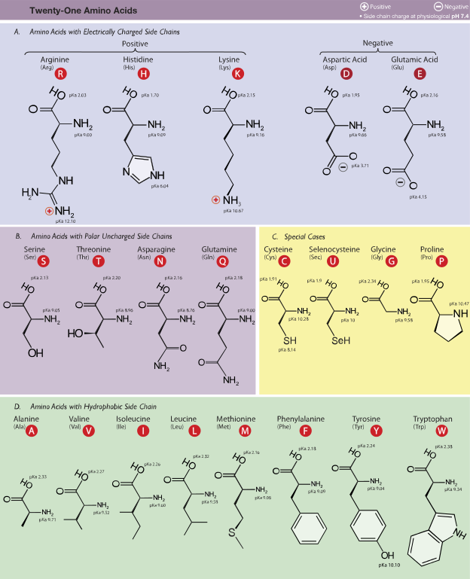
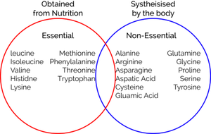

Slide 26
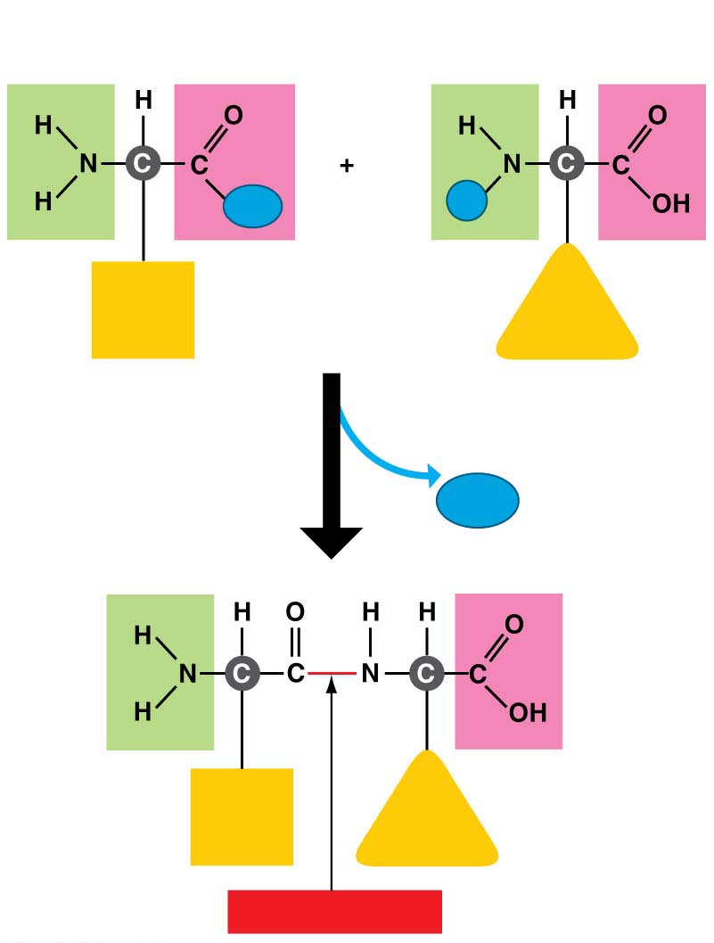
Structure/Function: Protein Shape
Cells link amino acids together by dehydration reactions,
forming peptide bonds,
and creating long chains of
amino acids called polypeptides.
A functional protein is one or more
polypeptide chains
precisely twisted, folded,
and coiled into a molecule of
unique shape.
Dehydration reaction
Notes:
26
Student Misconceptions and Concerns
1. The abstract nature of chemistry can be discouraging to many students. Consider starting out this section of the lecture by examining the chemical groups on a food nutrition label. Candy bars with peanuts are particularly useful as they contain significant amounts of all three sources of calories (carbohydrates, proteins, and lipids).
2. Students might struggle to extrapolate the properties of lipids to their roles in an organism. Ducks float because their feathers repel water instead of attracting it. Hair on your head remains flexible because of oils produced in your scalp. Examples such as these help connect the abstract properties of lipids to concrete examples in our world.
3. The functional significance of protein shape is an abstract molecular example of form and function relationships, which might be new to some students. The binding of an enzyme to its substrate is a type of molecular handshake, which permits specific interactions. To help students think about form and function relationships, share some concrete analogies in their lives—perhaps flathead and Phillips screwdrivers that match the proper type of screws or the fit of a hand into a glove.
4. The evolution of lactose tolerance within human groups in East Africa does not represent a deliberate decision, yet this evolutionary change appears logical. Many students perceive adaptations as deliberate events with purpose. As students develop a better understanding of the mechanisms of evolution, it will be important to point out that mutations arise by chance, with the culling hand of natural selection favoring traits that convey an advantage. Organisms cannot plan evolutionary change.
Teaching Tips
1. Consider reinforcing the three main sources of calories with food items that clearly represent each group. Bring clear examples to class as visual references, for example, a can of Coke or a bag of sugar for carbohydrates, a tub of margarine for lipids, and some beef jerky for protein (although some fat and carbohydrates might also be included).
2. If your lectures will eventually include details of glycolysis and aerobic respiration, this is a good point to introduce the basic concepts of glucose as fuel. Just introducing this conceptual formula might help: eating glucose + breathing in oxygen (yields) water + usable energy (used to build ATP) + heat + exhaled CO₂.
3. The section about our use of sugars may be of considerable interest to your students, who might not be expecting much interest in a lecture about organic chemistry. Consider an assignment for each student to bring to class a product label indicating high-fructose corn syrup (HFCS) as an ingredient.
4. Learning the definitions of word roots is invaluable when learning science. Learning the meaning of the prefix word roots “mono” (one), “di” (two), and “poly” (many) helps to distinguish the structures of various carbohydrates.
5. Consider an assignment for students to find reliable sources that discuss high sugar consumption in the modern diet. The key, of course, is in the quality of the resource. Consider narrowing down the categories to certain nonprofit health organizations (American Cancer Society, American Heart Association, and the like) and peer-reviewed journals.
6. A simple exercise demonstrates the enzymatic breakdown of starches into sugars. If students place an unsalted cracker in their mouths, holding it in their mouths while it mixes well with saliva, they might soon notice that a sweeter taste begins to emerge. The salivary enzyme amylase begins the digestion of starches into disaccharides, which may be degraded further by other enzymes. These disaccharides are the source of the sweet taste.
7. An adult human may store about a half of a kilogram of glycogen in the liver and muscles of the body, depending on recent dietary habits. A person who begins dieting might soon notice an immediate weight loss of 2–4 pounds (1–2 kilograms) over several days, reflecting reductions in stored glycogen, water, and intestinal contents (among other factors).
8. Another simple demonstration can illustrate hydrophobic and hydrophilic substances. In front of the class, mix colored water and a yellow oil (corn or canola oil work well). Shake up the mixture and then watch as the two separate. (You may have a mixture already made that remains separated; however, the dyes may bleed between the oil and the water.)
9. Margarine in stores commonly comes in liquid squeeze containers, in tubs, and in sticks. These forms reflect increasing amounts of hydrogenation, gradually increasing the stiffness from a liquid, to a firmer spread, to a firm stick of margarine. As noted in the text, recent studies have suggested that unsaturated oils become increasingly unhealthy as they are hydrogenated. Perhaps your students can find references to this correlation on the Internet.
10. Many analogies can help students understand the diversity of proteins that can be made from just 20 amino acids. The authors note that our language uses combinations of 26 letters to form words. Proteins are much longer “words,” creating even more diversity. Another analogy is to trains. This builds on the earlier analogy when polymers were introduced. Imagine making different trains about 100 cars long, using any combination of 20 types of railroad cars. Mathematically, the number of possible trains is 20¹⁰⁰, a number beyond imagination.
11. The authors note that the difference between a polypeptide and a protein is analogous to the relationship between a long strand of yarn and a sweater knitted from yarn. Proteins are clearly more complex!
12. Most cooking results in changes in the texture and color of a food. The brown color of a steak is the product of the denaturation of proteins. Fixatives such as formalin also denature proteins and cause color changes. Students who have dissected vertebrates will realize that the brown color of the muscles makes it look as if the animal has been cooked.
13. The “NA” in DNA and RNA stands for “nucleic acid.” Students often do not make this association without assistance.
Active Lecture Tips
1. The cellophane wrap often used to package foods is a biodegradable material derived from cellulose. Challenge students to work in pairs to create a list of other cellulose-derived products (such as paper).
2. Consider this assignment to finish a discussion of the diverse organic molecules in our diets. Have students work in pairs or small groups to analyze a food label listing the components of a McDonald’s Big Mac. Note the most abundant organic molecule class (perhaps by weight) found in each component.
3. See the Activity What Ingredients Make Up Your Snack Food on the Instructor Exchange. Visit the Instructor Exchange in the MasteringBiology instructor resource area for a description of this activity.
4. See the Activity Drawing Hydrophobic and Hydrophilic Interactions on the Instructor Exchange. Visit the Instructor Exchange in the MasteringBiology instructor resource area for a description of this activity.

Slide 27
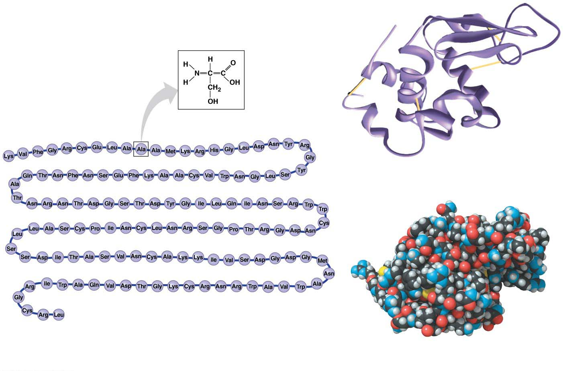
The amino acid sequence of each polypeptide determines the three-dimensional structure of the protein.
A protein’s three-dimensional structure enables the molecule to carry out its specific function.
Nearly all proteins work by recognizing and binding to some other molecule.
One amino acid
(alanine)
1차 구조
2차 구조
3차 구조
4차 구조
1
129
The amino acid sequence of lysozyme
Notes:
27
Student Misconceptions and Concerns
1. The abstract nature of chemistry can be discouraging to many students. Consider starting out this section of the lecture by examining the chemical groups on a food nutrition label. Candy bars with peanuts are particularly useful as they contain significant amounts of all three sources of calories (carbohydrates, proteins, and lipids).
2. Students might struggle to extrapolate the properties of lipids to their roles in an organism. Ducks float because their feathers repel water instead of attracting it. Hair on your head remains flexible because of oils produced in your scalp. Examples such as these help connect the abstract properties of lipids to concrete examples in our world.
3. The functional significance of protein shape is an abstract molecular example of form and function relationships, which might be new to some students. The binding of an enzyme to its substrate is a type of molecular handshake, which permits specific interactions. To help students think about form and function relationships, share some concrete analogies in their lives—perhaps flathead and Phillips screwdrivers that match the proper type of screws or the fit of a hand into a glove.
4. The evolution of lactose tolerance within human groups in East Africa does not represent a deliberate decision, yet this evolutionary change appears logical. Many students perceive adaptations as deliberate events with purpose. As students develop a better understanding of the mechanisms of evolution, it will be important to point out that mutations arise by chance, with the culling hand of natural selection favoring traits that convey an advantage. Organisms cannot plan evolutionary change.
Teaching Tips
1. Consider reinforcing the three main sources of calories with food items that clearly represent each group. Bring clear examples to class as visual references, for example, a can of Coke or a bag of sugar for carbohydrates, a tub of margarine for lipids, and some beef jerky for protein (although some fat and carbohydrates might also be included).
2. If your lectures will eventually include details of glycolysis and aerobic respiration, this is a good point to introduce the basic concepts of glucose as fuel. Just introducing this conceptual formula might help: eating glucose + breathing in oxygen (yields) water + usable energy (used to build ATP) + heat + exhaled CO₂.
3. The section about our use of sugars may be of considerable interest to your students, who might not be expecting much interest in a lecture about organic chemistry. Consider an assignment for each student to bring to class a product label indicating high-fructose corn syrup (HFCS) as an ingredient.
4. Learning the definitions of word roots is invaluable when learning science. Learning the meaning of the prefix word roots “mono” (one), “di” (two), and “poly” (many) helps to distinguish the structures of various carbohydrates.
5. Consider an assignment for students to find reliable sources that discuss high sugar consumption in the modern diet. The key, of course, is in the quality of the resource. Consider narrowing down the categories to certain nonprofit health organizations (American Cancer Society, American Heart Association, and the like) and peer-reviewed journals.
6. A simple exercise demonstrates the enzymatic breakdown of starches into sugars. If students place an unsalted cracker in their mouths, holding it in their mouths while it mixes well with saliva, they might soon notice that a sweeter taste begins to emerge. The salivary enzyme amylase begins the digestion of starches into disaccharides, which may be degraded further by other enzymes. These disaccharides are the source of the sweet taste.
7. An adult human may store about a half of a kilogram of glycogen in the liver and muscles of the body, depending on recent dietary habits. A person who begins dieting might soon notice an immediate weight loss of 2–4 pounds (1–2 kilograms) over several days, reflecting reductions in stored glycogen, water, and intestinal contents (among other factors).
8. Another simple demonstration can illustrate hydrophobic and hydrophilic substances. In front of the class, mix colored water and a yellow oil (corn or canola oil work well). Shake up the mixture and then watch as the two separate. (You may have a mixture already made that remains separated; however, the dyes may bleed between the oil and the water.)
9. Margarine in stores commonly comes in liquid squeeze containers, in tubs, and in sticks. These forms reflect increasing amounts of hydrogenation, gradually increasing the stiffness from a liquid, to a firmer spread, to a firm stick of margarine. As noted in the text, recent studies have suggested that unsaturated oils become increasingly unhealthy as they are hydrogenated. Perhaps your students can find references to this correlation on the Internet.
10. Many analogies can help students understand the diversity of proteins that can be made from just 20 amino acids. The authors note that our language uses combinations of 26 letters to form words. Proteins are much longer “words,” creating even more diversity. Another analogy is to trains. This builds on the earlier analogy when polymers were introduced. Imagine making different trains about 100 cars long, using any combination of 20 types of railroad cars. Mathematically, the number of possible trains is 20¹⁰⁰, a number beyond imagination.
11. The authors note that the difference between a polypeptide and a protein is analogous to the relationship between a long strand of yarn and a sweater knitted from yarn. Proteins are clearly more complex!
12. Most cooking results in changes in the texture and color of a food. The brown color of a steak is the product of the denaturation of proteins. Fixatives such as formalin also denature proteins and cause color changes. Students who have dissected vertebrates will realize that the brown color of the muscles makes it look as if the animal has been cooked.
13. The “NA” in DNA and RNA stands for “nucleic acid.” Students often do not make this association without assistance.
Active Lecture Tips
1. The cellophane wrap often used to package foods is a biodegradable material derived from cellulose. Challenge students to work in pairs to create a list of other cellulose-derived products (such as paper).
2. Consider this assignment to finish a discussion of the diverse organic molecules in our diets. Have students work in pairs or small groups to analyze a food label listing the components of a McDonald’s Big Mac. Note the most abundant organic molecule class (perhaps by weight) found in each component.
3. See the Activity What Ingredients Make Up Your Snack Food on the Instructor Exchange. Visit the Instructor Exchange in the MasteringBiology instructor resource area for a description of this activity.
4. See the Activity Drawing Hydrophobic and Hydrophilic Interactions on the Instructor Exchange. Visit the Instructor Exchange in the MasteringBiology instructor resource area for a description of this activity.

Slide 28
One difference in structure is enough to cause the protein to fold into a different shape, which alters its function, which in turn causes disease.
Misfolded proteins are associated with many diseases, including some severe nervous system disorders.
The diseases shown in Figure 3.20 are all caused by prions, misfolded versions of normal brain proteins.
A protein’s shape is sensitive to the environment. An unfavorable change in temperature, pH, or some other factor can cause a protein to unravel.
Notes:
28
Student Misconceptions and Concerns
1. The abstract nature of chemistry can be discouraging to many students. Consider starting out this section of the lecture by examining the chemical groups on a food nutrition label. Candy bars with peanuts are particularly useful as they contain significant amounts of all three sources of calories (carbohydrates, proteins, and lipids).
2. Students might struggle to extrapolate the properties of lipids to their roles in an organism. Ducks float because their feathers repel water instead of attracting it. Hair on your head remains flexible because of oils produced in your scalp. Examples such as these help connect the abstract properties of lipids to concrete examples in our world.
3. The functional significance of protein shape is an abstract molecular example of form and function relationships, which might be new to some students. The binding of an enzyme to its substrate is a type of molecular handshake, which permits specific interactions. To help students think about form and function relationships, share some concrete analogies in their lives—perhaps flathead and Phillips screwdrivers that match the proper type of screws or the fit of a hand into a glove.
4. The evolution of lactose tolerance within human groups in East Africa does not represent a deliberate decision, yet this evolutionary change appears logical. Many students perceive adaptations as deliberate events with purpose. As students develop a better understanding of the mechanisms of evolution, it will be important to point out that mutations arise by chance, with the culling hand of natural selection favoring traits that convey an advantage. Organisms cannot plan evolutionary change.
Teaching Tips
1. Consider reinforcing the three main sources of calories with food items that clearly represent each group. Bring clear examples to class as visual references, for example, a can of Coke or a bag of sugar for carbohydrates, a tub of margarine for lipids, and some beef jerky for protein (although some fat and carbohydrates might also be included).
2. If your lectures will eventually include details of glycolysis and aerobic respiration, this is a good point to introduce the basic concepts of glucose as fuel. Just introducing this conceptual formula might help: eating glucose + breathing in oxygen (yields) water + usable energy (used to build ATP) + heat + exhaled CO₂.
3. The section about our use of sugars may be of considerable interest to your students, who might not be expecting much interest in a lecture about organic chemistry. Consider an assignment for each student to bring to class a product label indicating high-fructose corn syrup (HFCS) as an ingredient.
4. Learning the definitions of word roots is invaluable when learning science. Learning the meaning of the prefix word roots “mono” (one), “di” (two), and “poly” (many) helps to distinguish the structures of various carbohydrates.
5. Consider an assignment for students to find reliable sources that discuss high sugar consumption in the modern diet. The key, of course, is in the quality of the resource. Consider narrowing down the categories to certain nonprofit health organizations (American Cancer Society, American Heart Association, and the like) and peer-reviewed journals.
6. A simple exercise demonstrates the enzymatic breakdown of starches into sugars. If students place an unsalted cracker in their mouths, holding it in their mouths while it mixes well with saliva, they might soon notice that a sweeter taste begins to emerge. The salivary enzyme amylase begins the digestion of starches into disaccharides, which may be degraded further by other enzymes. These disaccharides are the source of the sweet taste.
7. An adult human may store about a half of a kilogram of glycogen in the liver and muscles of the body, depending on recent dietary habits. A person who begins dieting might soon notice an immediate weight loss of 2–4 pounds (1–2 kilograms) over several days, reflecting reductions in stored glycogen, water, and intestinal contents (among other factors).
8. Another simple demonstration can illustrate hydrophobic and hydrophilic substances. In front of the class, mix colored water and a yellow oil (corn or canola oil work well). Shake up the mixture and then watch as the two separate. (You may have a mixture already made that remains separated; however, the dyes may bleed between the oil and the water.)
9. Margarine in stores commonly comes in liquid squeeze containers, in tubs, and in sticks. These forms reflect increasing amounts of hydrogenation, gradually increasing the stiffness from a liquid, to a firmer spread, to a firm stick of margarine. As noted in the text, recent studies have suggested that unsaturated oils become increasingly unhealthy as they are hydrogenated. Perhaps your students can find references to this correlation on the Internet.
10. Many analogies can help students understand the diversity of proteins that can be made from just 20 amino acids. The authors note that our language uses combinations of 26 letters to form words. Proteins are much longer “words,” creating even more diversity. Another analogy is to trains. This builds on the earlier analogy when polymers were introduced. Imagine making different trains about 100 cars long, using any combination of 20 types of railroad cars. Mathematically, the number of possible trains is 20¹⁰⁰, a number beyond imagination.
11. The authors note that the difference between a polypeptide and a protein is analogous to the relationship between a long strand of yarn and a sweater knitted from yarn. Proteins are clearly more complex!
12. Most cooking results in changes in the texture and color of a food. The brown color of a steak is the product of the denaturation of proteins. Fixatives such as formalin also denature proteins and cause color changes. Students who have dissected vertebrates will realize that the brown color of the muscles makes it look as if the animal has been cooked.
13. The “NA” in DNA and RNA stands for “nucleic acid.” Students often do not make this association without assistance.
Active Lecture Tips
1. The cellophane wrap often used to package foods is a biodegradable material derived from cellulose. Challenge students to work in pairs to create a list of other cellulose-derived products (such as paper).
2. Consider this assignment to finish a discussion of the diverse organic molecules in our diets. Have students work in pairs or small groups to analyze a food label listing the components of a McDonald’s Big Mac. Note the most abundant organic molecule class (perhaps by weight) found in each component.
3. See the Activity What Ingredients Make Up Your Snack Food on the Instructor Exchange. Visit the Instructor Exchange in the MasteringBiology instructor resource area for a description of this activity.
4. See the Activity Drawing Hydrophobic and Hydrophilic Interactions on the Instructor Exchange. Visit the Instructor Exchange in the MasteringBiology instructor resource area for a description of this activity.

Slide 29
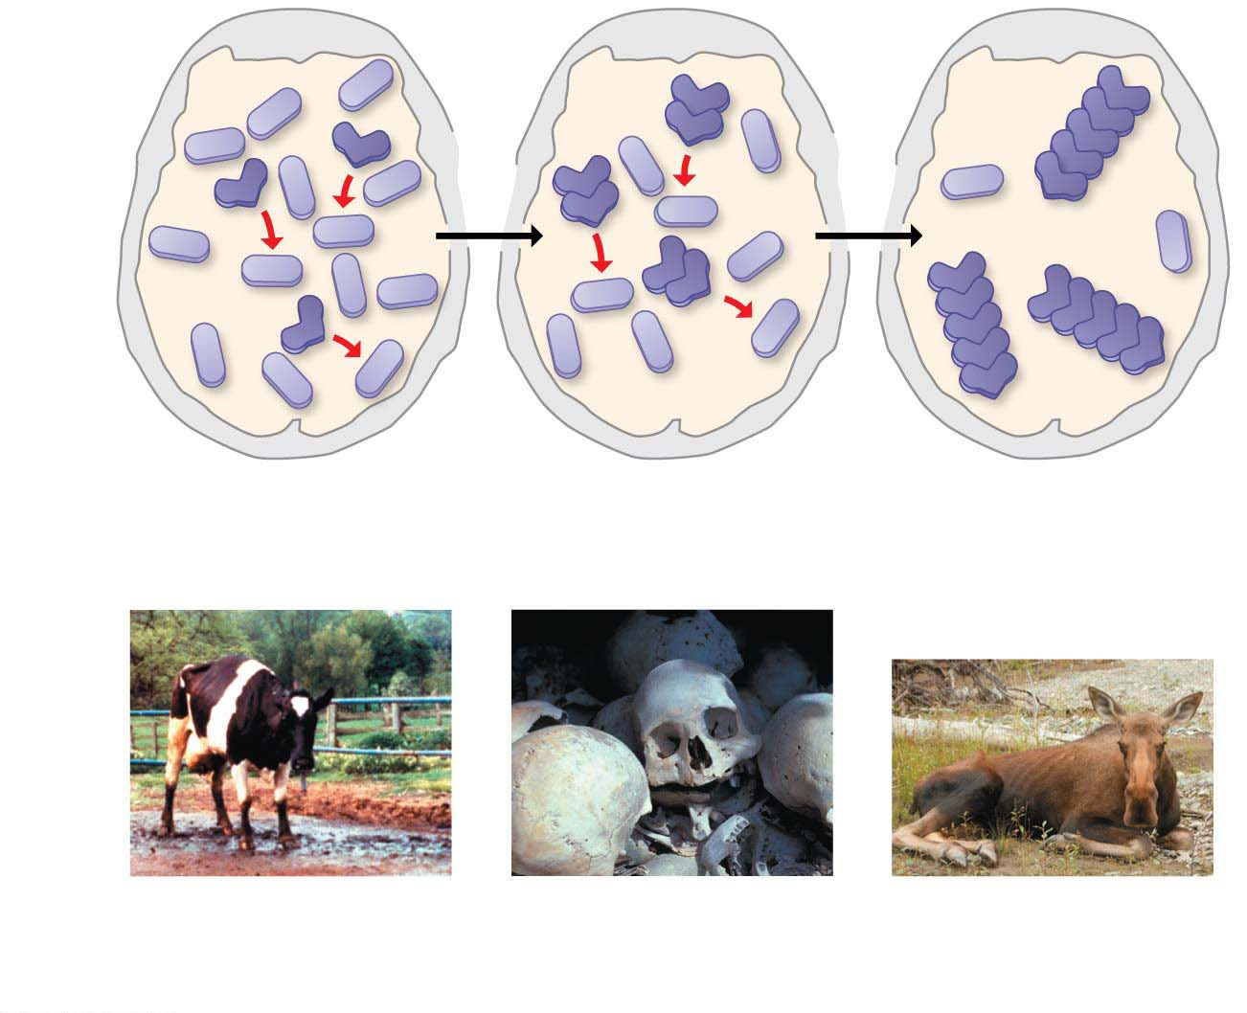
Figure 3.20
Normal
protein
Prion
Clusters
of prions
Skull
Prion
converts
normal
proteins
Prion
proteins
clump
together
Brain
Bovine spongiform
encephalopathy
(BSE)
Kuru
Fatal weight loss in
deer, elk, and moose
Notes:
Figure 3.20 How an improperly folded protein can lead to brain disease

Slide 30
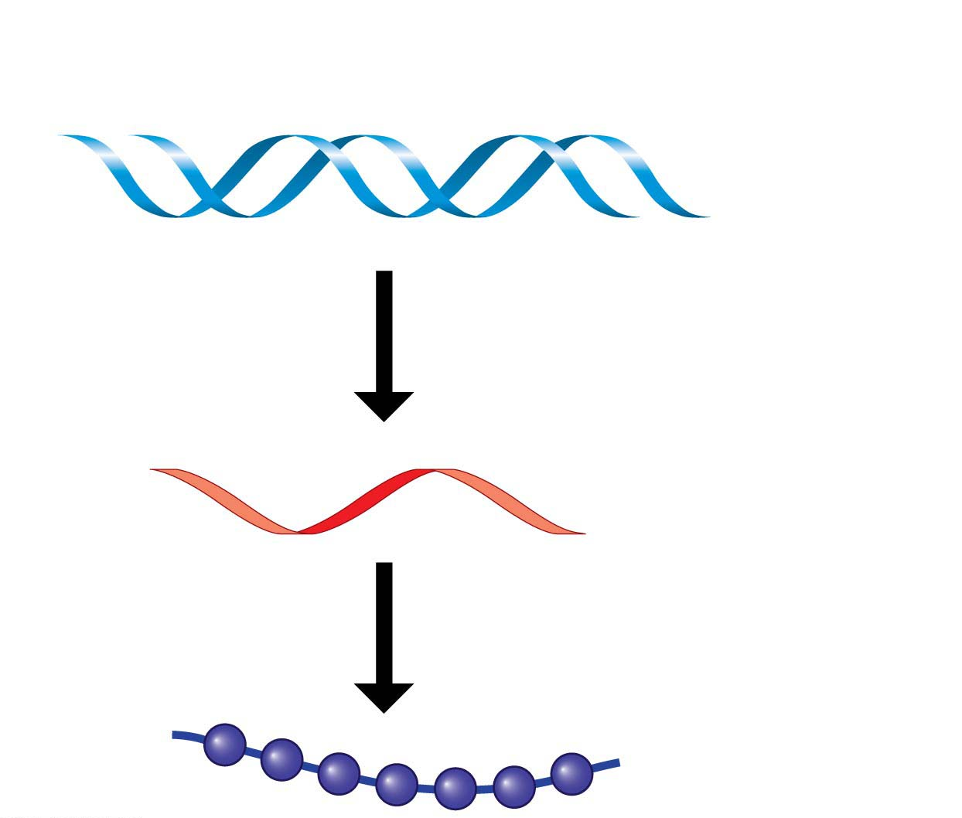
Nucleic Acids
Nucleic acids핵산 are macromolecules that
store information and
provide the instructions for building proteins.
They consist of two types:
DNA (deoxyribonucleic acid) and
RNA (ribonucleic acid).
A gene is a unit of inheritance encoded in a specific stretch of DNA that programs the amino acid sequence of a polypeptide.
DNA
RNA
Protein
Notes:
30
Student Misconceptions and Concerns
1. The abstract nature of chemistry can be discouraging to many students. Consider starting out this section of the lecture by examining the chemical groups on a food nutrition label. Candy bars with peanuts are particularly useful as they contain significant amounts of all three sources of calories (carbohydrates, proteins, and lipids).
2. Students might struggle to extrapolate the properties of lipids to their roles in an organism. Ducks float because their feathers repel water instead of attracting it. Hair on your head remains flexible because of oils produced in your scalp. Examples such as these help connect the abstract properties of lipids to concrete examples in our world.
3. The functional significance of protein shape is an abstract molecular example of form and function relationships, which might be new to some students. The binding of an enzyme to its substrate is a type of molecular handshake, which permits specific interactions. To help students think about form and function relationships, share some concrete analogies in their lives—perhaps flathead and Phillips screwdrivers that match the proper type of screws or the fit of a hand into a glove.
4. The evolution of lactose tolerance within human groups in East Africa does not represent a deliberate decision, yet this evolutionary change appears logical. Many students perceive adaptations as deliberate events with purpose. As students develop a better understanding of the mechanisms of evolution, it will be important to point out that mutations arise by chance, with the culling hand of natural selection favoring traits that convey an advantage. Organisms cannot plan evolutionary change.
Teaching Tips
1. Consider reinforcing the three main sources of calories with food items that clearly represent each group. Bring clear examples to class as visual references, for example, a can of Coke or a bag of sugar for carbohydrates, a tub of margarine for lipids, and some beef jerky for protein (although some fat and carbohydrates might also be included).
2. If your lectures will eventually include details of glycolysis and aerobic respiration, this is a good point to introduce the basic concepts of glucose as fuel. Just introducing this conceptual formula might help: eating glucose + breathing in oxygen (yields) water + usable energy (used to build ATP) + heat + exhaled CO₂.
3. The section about our use of sugars may be of considerable interest to your students, who might not be expecting much interest in a lecture about organic chemistry. Consider an assignment for each student to bring to class a product label indicating high-fructose corn syrup (HFCS) as an ingredient.
4. Learning the definitions of word roots is invaluable when learning science. Learning the meaning of the prefix word roots “mono” (one), “di” (two), and “poly” (many) helps to distinguish the structures of various carbohydrates.
5. Consider an assignment for students to find reliable sources that discuss high sugar consumption in the modern diet. The key, of course, is in the quality of the resource. Consider narrowing down the categories to certain nonprofit health organizations (American Cancer Society, American Heart Association, and the like) and peer-reviewed journals.
6. A simple exercise demonstrates the enzymatic breakdown of starches into sugars. If students place an unsalted cracker in their mouths, holding it in their mouths while it mixes well with saliva, they might soon notice that a sweeter taste begins to emerge. The salivary enzyme amylase begins the digestion of starches into disaccharides, which may be degraded further by other enzymes. These disaccharides are the source of the sweet taste.
7. An adult human may store about a half of a kilogram of glycogen in the liver and muscles of the body, depending on recent dietary habits. A person who begins dieting might soon notice an immediate weight loss of 2–4 pounds (1–2 kilograms) over several days, reflecting reductions in stored glycogen, water, and intestinal contents (among other factors).
8. Another simple demonstration can illustrate hydrophobic and hydrophilic substances. In front of the class, mix colored water and a yellow oil (corn or canola oil work well). Shake up the mixture and then watch as the two separate. (You may have a mixture already made that remains separated; however, the dyes may bleed between the oil and the water.)
9. Margarine in stores commonly comes in liquid squeeze containers, in tubs, and in sticks. These forms reflect increasing amounts of hydrogenation, gradually increasing the stiffness from a liquid, to a firmer spread, to a firm stick of margarine. As noted in the text, recent studies have suggested that unsaturated oils become increasingly unhealthy as they are hydrogenated. Perhaps your students can find references to this correlation on the Internet.
10. Many analogies can help students understand the diversity of proteins that can be made from just 20 amino acids. The authors note that our language uses combinations of 26 letters to form words. Proteins are much longer “words,” creating even more diversity. Another analogy is to trains. This builds on the earlier analogy when polymers were introduced. Imagine making different trains about 100 cars long, using any combination of 20 types of railroad cars. Mathematically, the number of possible trains is 20¹⁰⁰, a number beyond imagination.
11. The authors note that the difference between a polypeptide and a protein is analogous to the relationship between a long strand of yarn and a sweater knitted from yarn. Proteins are clearly more complex!
12. Most cooking results in changes in the texture and color of a food. The brown color of a steak is the product of the denaturation of proteins. Fixatives such as formalin also denature proteins and cause color changes. Students who have dissected vertebrates will realize that the brown color of the muscles makes it look as if the animal has been cooked.
13. The “NA” in DNA and RNA stands for “nucleic acid.” Students often do not make this association without assistance.
Active Lecture Tips
1. The cellophane wrap often used to package foods is a biodegradable material derived from cellulose. Challenge students to work in pairs to create a list of other cellulose-derived products (such as paper).
2. Consider this assignment to finish a discussion of the diverse organic molecules in our diets. Have students work in pairs or small groups to analyze a food label listing the components of a McDonald’s Big Mac. Note the most abundant organic molecule class (perhaps by weight) found in each component.
3. See the Activity What Ingredients Make Up Your Snack Food on the Instructor Exchange. Visit the Instructor Exchange in the MasteringBiology instructor resource area for a description of this activity.
4. See the Activity Drawing Hydrophobic and Hydrophilic Interactions on the Instructor Exchange. Visit the Instructor Exchange in the MasteringBiology instructor resource area for a description of this activity.

Slide 31
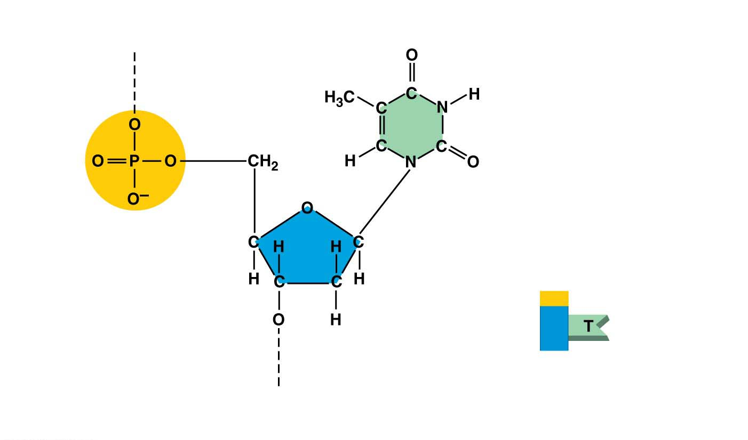
Nucleic acids are polymers made from monomers called nucleotides.
Each nucleotide has three parts:
a five-carbon sugar,
a phosphate group, and
a nitrogen-containing base.
Thymine (T)
(a) Atomic structure
Phosphate
Base
Sugar
(b) Symbol used in this book
Notes:
31
Student Misconceptions and Concerns
1. The abstract nature of chemistry can be discouraging to many students. Consider starting out this section of the lecture by examining the chemical groups on a food nutrition label. Candy bars with peanuts are particularly useful as they contain significant amounts of all three sources of calories (carbohydrates, proteins, and lipids).
2. Students might struggle to extrapolate the properties of lipids to their roles in an organism. Ducks float because their feathers repel water instead of attracting it. Hair on your head remains flexible because of oils produced in your scalp. Examples such as these help connect the abstract properties of lipids to concrete examples in our world.
3. The functional significance of protein shape is an abstract molecular example of form and function relationships, which might be new to some students. The binding of an enzyme to its substrate is a type of molecular handshake, which permits specific interactions. To help students think about form and function relationships, share some concrete analogies in their lives—perhaps flathead and Phillips screwdrivers that match the proper type of screws or the fit of a hand into a glove.
4. The evolution of lactose tolerance within human groups in East Africa does not represent a deliberate decision, yet this evolutionary change appears logical. Many students perceive adaptations as deliberate events with purpose. As students develop a better understanding of the mechanisms of evolution, it will be important to point out that mutations arise by chance, with the culling hand of natural selection favoring traits that convey an advantage. Organisms cannot plan evolutionary change.
Teaching Tips
1. Consider reinforcing the three main sources of calories with food items that clearly represent each group. Bring clear examples to class as visual references, for example, a can of Coke or a bag of sugar for carbohydrates, a tub of margarine for lipids, and some beef jerky for protein (although some fat and carbohydrates might also be included).
2. If your lectures will eventually include details of glycolysis and aerobic respiration, this is a good point to introduce the basic concepts of glucose as fuel. Just introducing this conceptual formula might help: eating glucose + breathing in oxygen (yields) water + usable energy (used to build ATP) + heat + exhaled CO₂.
3. The section about our use of sugars may be of considerable interest to your students, who might not be expecting much interest in a lecture about organic chemistry. Consider an assignment for each student to bring to class a product label indicating high-fructose corn syrup (HFCS) as an ingredient.
4. Learning the definitions of word roots is invaluable when learning science. Learning the meaning of the prefix word roots “mono” (one), “di” (two), and “poly” (many) helps to distinguish the structures of various carbohydrates.
5. Consider an assignment for students to find reliable sources that discuss high sugar consumption in the modern diet. The key, of course, is in the quality of the resource. Consider narrowing down the categories to certain nonprofit health organizations (American Cancer Society, American Heart Association, and the like) and peer-reviewed journals.
6. A simple exercise demonstrates the enzymatic breakdown of starches into sugars. If students place an unsalted cracker in their mouths, holding it in their mouths while it mixes well with saliva, they might soon notice that a sweeter taste begins to emerge. The salivary enzyme amylase begins the digestion of starches into disaccharides, which may be degraded further by other enzymes. These disaccharides are the source of the sweet taste.
7. An adult human may store about a half of a kilogram of glycogen in the liver and muscles of the body, depending on recent dietary habits. A person who begins dieting might soon notice an immediate weight loss of 2–4 pounds (1–2 kilograms) over several days, reflecting reductions in stored glycogen, water, and intestinal contents (among other factors).
8. Another simple demonstration can illustrate hydrophobic and hydrophilic substances. In front of the class, mix colored water and a yellow oil (corn or canola oil work well). Shake up the mixture and then watch as the two separate. (You may have a mixture already made that remains separated; however, the dyes may bleed between the oil and the water.)
9. Margarine in stores commonly comes in liquid squeeze containers, in tubs, and in sticks. These forms reflect increasing amounts of hydrogenation, gradually increasing the stiffness from a liquid, to a firmer spread, to a firm stick of margarine. As noted in the text, recent studies have suggested that unsaturated oils become increasingly unhealthy as they are hydrogenated. Perhaps your students can find references to this correlation on the Internet.
10. Many analogies can help students understand the diversity of proteins that can be made from just 20 amino acids. The authors note that our language uses combinations of 26 letters to form words. Proteins are much longer “words,” creating even more diversity. Another analogy is to trains. This builds on the earlier analogy when polymers were introduced. Imagine making different trains about 100 cars long, using any combination of 20 types of railroad cars. Mathematically, the number of possible trains is 20¹⁰⁰, a number beyond imagination.
11. The authors note that the difference between a polypeptide and a protein is analogous to the relationship between a long strand of yarn and a sweater knitted from yarn. Proteins are clearly more complex!
12. Most cooking results in changes in the texture and color of a food. The brown color of a steak is the product of the denaturation of proteins. Fixatives such as formalin also denature proteins and cause color changes. Students who have dissected vertebrates will realize that the brown color of the muscles makes it look as if the animal has been cooked.
13. The “NA” in DNA and RNA stands for “nucleic acid.” Students often do not make this association without assistance.
Active Lecture Tips
1. The cellophane wrap often used to package foods is a biodegradable material derived from cellulose. Challenge students to work in pairs to create a list of other cellulose-derived products (such as paper).
2. Consider this assignment to finish a discussion of the diverse organic molecules in our diets. Have students work in pairs or small groups to analyze a food label listing the components of a McDonald’s Big Mac. Note the most abundant organic molecule class (perhaps by weight) found in each component.
3. See the Activity What Ingredients Make Up Your Snack Food on the Instructor Exchange. Visit the Instructor Exchange in the MasteringBiology instructor resource area for a description of this activity.
4. See the Activity Drawing Hydrophobic and Hydrophilic Interactions on the Instructor Exchange. Visit the Instructor Exchange in the MasteringBiology instructor resource area for a description of this activity.

Slide 32
Each DNA nucleotide has one of four possible nitrogenous bases:
adenine (A),
guanine (G),
thymine (T), or
cytosine (C).
Notes:
32
Student Misconceptions and Concerns
1. The abstract nature of chemistry can be discouraging to many students. Consider starting out this section of the lecture by examining the chemical groups on a food nutrition label. Candy bars with peanuts are particularly useful as they contain significant amounts of all three sources of calories (carbohydrates, proteins, and lipids).
2. Students might struggle to extrapolate the properties of lipids to their roles in an organism. Ducks float because their feathers repel water instead of attracting it. Hair on your head remains flexible because of oils produced in your scalp. Examples such as these help connect the abstract properties of lipids to concrete examples in our world.
3. The functional significance of protein shape is an abstract molecular example of form and function relationships, which might be new to some students. The binding of an enzyme to its substrate is a type of molecular handshake, which permits specific interactions. To help students think about form and function relationships, share some concrete analogies in their lives—perhaps flathead and Phillips screwdrivers that match the proper type of screws or the fit of a hand into a glove.
4. The evolution of lactose tolerance within human groups in East Africa does not represent a deliberate decision, yet this evolutionary change appears logical. Many students perceive adaptations as deliberate events with purpose. As students develop a better understanding of the mechanisms of evolution, it will be important to point out that mutations arise by chance, with the culling hand of natural selection favoring traits that convey an advantage. Organisms cannot plan evolutionary change.
Teaching Tips
1. Consider reinforcing the three main sources of calories with food items that clearly represent each group. Bring clear examples to class as visual references, for example, a can of Coke or a bag of sugar for carbohydrates, a tub of margarine for lipids, and some beef jerky for protein (although some fat and carbohydrates might also be included).
2. If your lectures will eventually include details of glycolysis and aerobic respiration, this is a good point to introduce the basic concepts of glucose as fuel. Just introducing this conceptual formula might help: eating glucose + breathing in oxygen (yields) water + usable energy (used to build ATP) + heat + exhaled CO₂.
3. The section about our use of sugars may be of considerable interest to your students, who might not be expecting much interest in a lecture about organic chemistry. Consider an assignment for each student to bring to class a product label indicating high-fructose corn syrup (HFCS) as an ingredient.
4. Learning the definitions of word roots is invaluable when learning science. Learning the meaning of the prefix word roots “mono” (one), “di” (two), and “poly” (many) helps to distinguish the structures of various carbohydrates.
5. Consider an assignment for students to find reliable sources that discuss high sugar consumption in the modern diet. The key, of course, is in the quality of the resource. Consider narrowing down the categories to certain nonprofit health organizations (American Cancer Society, American Heart Association, and the like) and peer-reviewed journals.
6. A simple exercise demonstrates the enzymatic breakdown of starches into sugars. If students place an unsalted cracker in their mouths, holding it in their mouths while it mixes well with saliva, they might soon notice that a sweeter taste begins to emerge. The salivary enzyme amylase begins the digestion of starches into disaccharides, which may be degraded further by other enzymes. These disaccharides are the source of the sweet taste.
7. An adult human may store about a half of a kilogram of glycogen in the liver and muscles of the body, depending on recent dietary habits. A person who begins dieting might soon notice an immediate weight loss of 2–4 pounds (1–2 kilograms) over several days, reflecting reductions in stored glycogen, water, and intestinal contents (among other factors).
8. Another simple demonstration can illustrate hydrophobic and hydrophilic substances. In front of the class, mix colored water and a yellow oil (corn or canola oil work well). Shake up the mixture and then watch as the two separate. (You may have a mixture already made that remains separated; however, the dyes may bleed between the oil and the water.)
9. Margarine in stores commonly comes in liquid squeeze containers, in tubs, and in sticks. These forms reflect increasing amounts of hydrogenation, gradually increasing the stiffness from a liquid, to a firmer spread, to a firm stick of margarine. As noted in the text, recent studies have suggested that unsaturated oils become increasingly unhealthy as they are hydrogenated. Perhaps your students can find references to this correlation on the Internet.
10. Many analogies can help students understand the diversity of proteins that can be made from just 20 amino acids. The authors note that our language uses combinations of 26 letters to form words. Proteins are much longer “words,” creating even more diversity. Another analogy is to trains. This builds on the earlier analogy when polymers were introduced. Imagine making different trains about 100 cars long, using any combination of 20 types of railroad cars. Mathematically, the number of possible trains is 20¹⁰⁰, a number beyond imagination.
11. The authors note that the difference between a polypeptide and a protein is analogous to the relationship between a long strand of yarn and a sweater knitted from yarn. Proteins are clearly more complex!
12. Most cooking results in changes in the texture and color of a food. The brown color of a steak is the product of the denaturation of proteins. Fixatives such as formalin also denature proteins and cause color changes. Students who have dissected vertebrates will realize that the brown color of the muscles makes it look as if the animal has been cooked.
13. The “NA” in DNA and RNA stands for “nucleic acid.” Students often do not make this association without assistance.
Active Lecture Tips
1. The cellophane wrap often used to package foods is a biodegradable material derived from cellulose. Challenge students to work in pairs to create a list of other cellulose-derived products (such as paper).
2. Consider this assignment to finish a discussion of the diverse organic molecules in our diets. Have students work in pairs or small groups to analyze a food label listing the components of a McDonald’s Big Mac. Note the most abundant organic molecule class (perhaps by weight) found in each component.
3. See the Activity What Ingredients Make Up Your Snack Food on the Instructor Exchange. Visit the Instructor Exchange in the MasteringBiology instructor resource area for a description of this activity.
4. See the Activity Drawing Hydrophobic and Hydrophilic Interactions on the Instructor Exchange. Visit the Instructor Exchange in the MasteringBiology instructor resource area for a description of this activity.

Slide 33
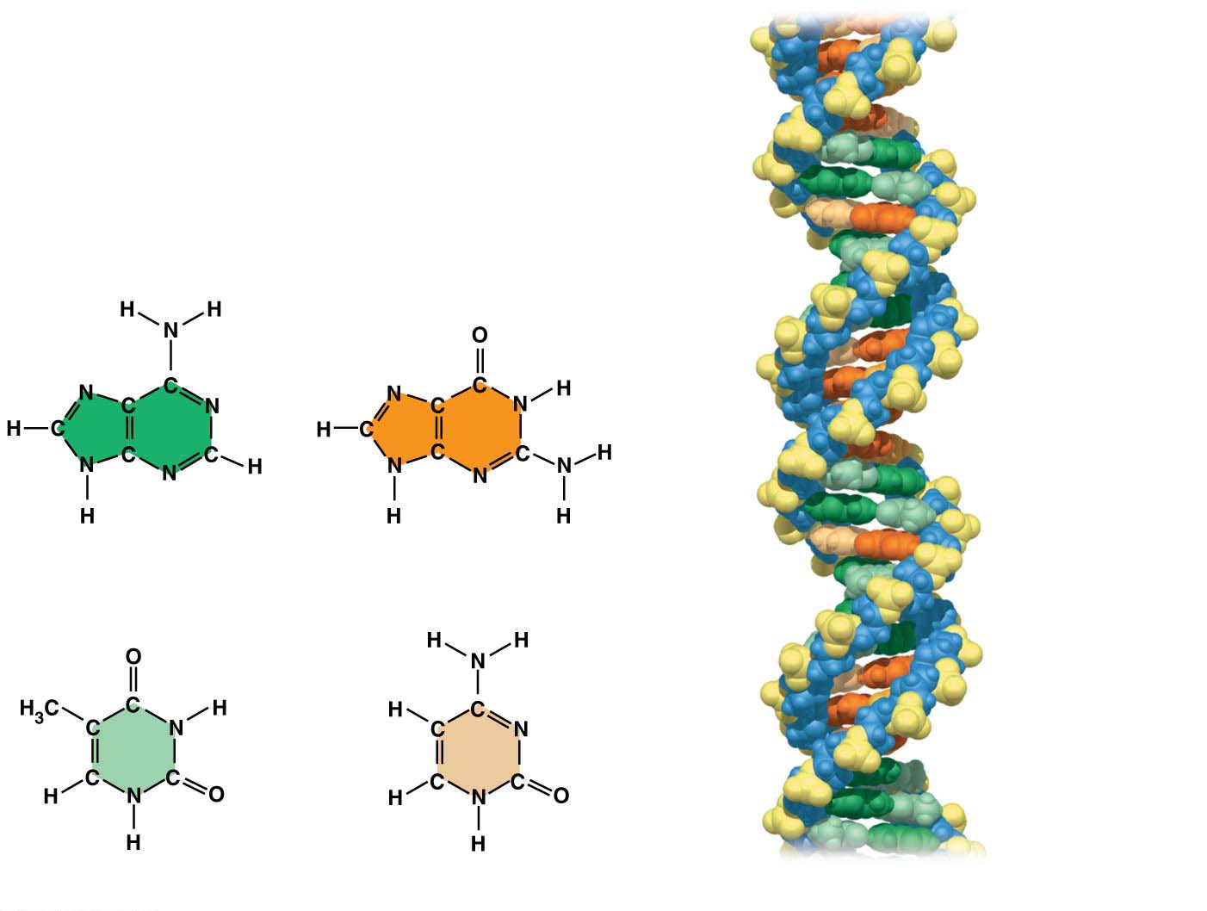
Figure 3.23
Adenine (A)
Guanine (G)
Thymine (T)
Adenine (A)
Guanine (G)
Cytosine (C)
Thymine (T)
Cytosine (C)
Space-filling model of DNA
Notes:
Figure 3.23 The nitrogenous bases of DNA

Slide 34
Dehydration reactions
link nucleotide monomers into long chains called polynucleotides,
form covalent bonds between the sugar of one nucleotide and the phosphate of the next, and
form a sugar-phosphate backbone.
Bases (A, T, C, or G) hang off the backbone like appendages.
Notes:
34
Student Misconceptions and Concerns
1. The abstract nature of chemistry can be discouraging to many students. Consider starting out this section of the lecture by examining the chemical groups on a food nutrition label. Candy bars with peanuts are particularly useful as they contain significant amounts of all three sources of calories (carbohydrates, proteins, and lipids).
2. Students might struggle to extrapolate the properties of lipids to their roles in an organism. Ducks float because their feathers repel water instead of attracting it. Hair on your head remains flexible because of oils produced in your scalp. Examples such as these help connect the abstract properties of lipids to concrete examples in our world.
3. The functional significance of protein shape is an abstract molecular example of form and function relationships, which might be new to some students. The binding of an enzyme to its substrate is a type of molecular handshake, which permits specific interactions. To help students think about form and function relationships, share some concrete analogies in their lives—perhaps flathead and Phillips screwdrivers that match the proper type of screws or the fit of a hand into a glove.
4. The evolution of lactose tolerance within human groups in East Africa does not represent a deliberate decision, yet this evolutionary change appears logical. Many students perceive adaptations as deliberate events with purpose. As students develop a better understanding of the mechanisms of evolution, it will be important to point out that mutations arise by chance, with the culling hand of natural selection favoring traits that convey an advantage. Organisms cannot plan evolutionary change.
Teaching Tips
1. Consider reinforcing the three main sources of calories with food items that clearly represent each group. Bring clear examples to class as visual references, for example, a can of Coke or a bag of sugar for carbohydrates, a tub of margarine for lipids, and some beef jerky for protein (although some fat and carbohydrates might also be included).
2. If your lectures will eventually include details of glycolysis and aerobic respiration, this is a good point to introduce the basic concepts of glucose as fuel. Just introducing this conceptual formula might help: eating glucose + breathing in oxygen (yields) water + usable energy (used to build ATP) + heat + exhaled CO₂.
3. The section about our use of sugars may be of considerable interest to your students, who might not be expecting much interest in a lecture about organic chemistry. Consider an assignment for each student to bring to class a product label indicating high-fructose corn syrup (HFCS) as an ingredient.
4. Learning the definitions of word roots is invaluable when learning science. Learning the meaning of the prefix word roots “mono” (one), “di” (two), and “poly” (many) helps to distinguish the structures of various carbohydrates.
5. Consider an assignment for students to find reliable sources that discuss high sugar consumption in the modern diet. The key, of course, is in the quality of the resource. Consider narrowing down the categories to certain nonprofit health organizations (American Cancer Society, American Heart Association, and the like) and peer-reviewed journals.
6. A simple exercise demonstrates the enzymatic breakdown of starches into sugars. If students place an unsalted cracker in their mouths, holding it in their mouths while it mixes well with saliva, they might soon notice that a sweeter taste begins to emerge. The salivary enzyme amylase begins the digestion of starches into disaccharides, which may be degraded further by other enzymes. These disaccharides are the source of the sweet taste.
7. An adult human may store about a half of a kilogram of glycogen in the liver and muscles of the body, depending on recent dietary habits. A person who begins dieting might soon notice an immediate weight loss of 2–4 pounds (1–2 kilograms) over several days, reflecting reductions in stored glycogen, water, and intestinal contents (among other factors).
8. Another simple demonstration can illustrate hydrophobic and hydrophilic substances. In front of the class, mix colored water and a yellow oil (corn or canola oil work well). Shake up the mixture and then watch as the two separate. (You may have a mixture already made that remains separated; however, the dyes may bleed between the oil and the water.)
9. Margarine in stores commonly comes in liquid squeeze containers, in tubs, and in sticks. These forms reflect increasing amounts of hydrogenation, gradually increasing the stiffness from a liquid, to a firmer spread, to a firm stick of margarine. As noted in the text, recent studies have suggested that unsaturated oils become increasingly unhealthy as they are hydrogenated. Perhaps your students can find references to this correlation on the Internet.
10. Many analogies can help students understand the diversity of proteins that can be made from just 20 amino acids. The authors note that our language uses combinations of 26 letters to form words. Proteins are much longer “words,” creating even more diversity. Another analogy is to trains. This builds on the earlier analogy when polymers were introduced. Imagine making different trains about 100 cars long, using any combination of 20 types of railroad cars. Mathematically, the number of possible trains is 20¹⁰⁰, a number beyond imagination.
11. The authors note that the difference between a polypeptide and a protein is analogous to the relationship between a long strand of yarn and a sweater knitted from yarn. Proteins are clearly more complex!
12. Most cooking results in changes in the texture and color of a food. The brown color of a steak is the product of the denaturation of proteins. Fixatives such as formalin also denature proteins and cause color changes. Students who have dissected vertebrates will realize that the brown color of the muscles makes it look as if the animal has been cooked.
13. The “NA” in DNA and RNA stands for “nucleic acid.” Students often do not make this association without assistance.
Active Lecture Tips
1. The cellophane wrap often used to package foods is a biodegradable material derived from cellulose. Challenge students to work in pairs to create a list of other cellulose-derived products (such as paper).
2. Consider this assignment to finish a discussion of the diverse organic molecules in our diets. Have students work in pairs or small groups to analyze a food label listing the components of a McDonald’s Big Mac. Note the most abundant organic molecule class (perhaps by weight) found in each component.
3. See the Activity What Ingredients Make Up Your Snack Food on the Instructor Exchange. Visit the Instructor Exchange in the MasteringBiology instructor resource area for a description of this activity.
4. See the Activity Drawing Hydrophobic and Hydrophilic Interactions on the Instructor Exchange. Visit the Instructor Exchange in the MasteringBiology instructor resource area for a description of this activity.

Slide 35
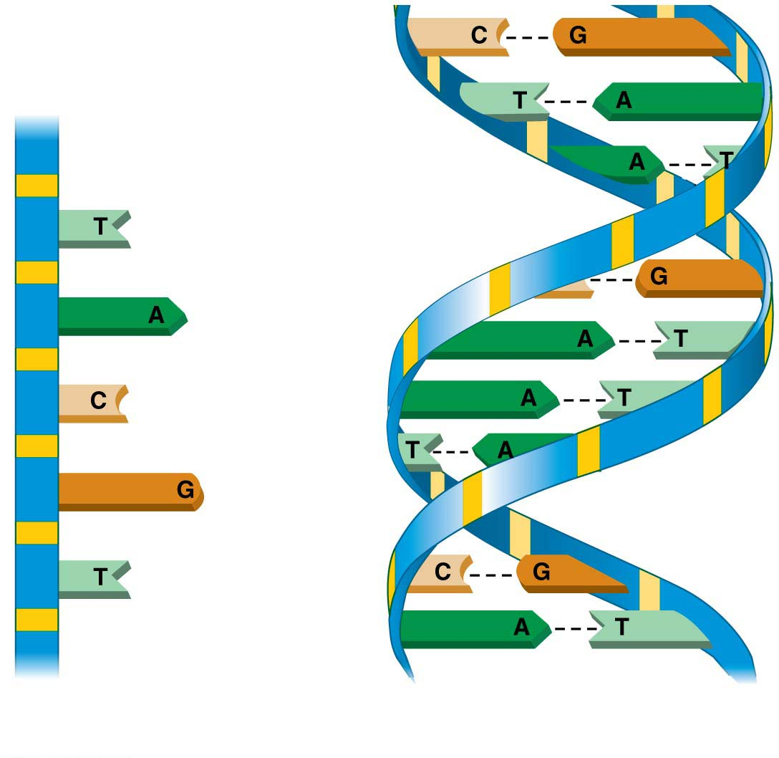
Figure 3.24
Sugar-phosphate
backbone
Nucleotide
Bases
(a) DNA strand
(polynucleotide)
Notes:
Figure 3.24 The structure of DNA

Slide 36
Figure 3.24
Base
pair
Hydrogen
bond
A only pairs with T and G can only pair with C.
(b) Double helix
(two polynucleotide strands)
Notes:
Figure 3.24 The structure of DNA

Slide 37
There are three important differences between DNA and RNA.
As its name ribonucleic acid denotes, the RNA sugar is ribose rather than deoxyribose in DNA.
Instead of the base thymine, RNA has a similar but distinct base called uracil (U).
RNA is usually found in single-stranded form, whereas DNA usually exists as a double helix.
Notes:
37
Student Misconceptions and Concerns
1. The abstract nature of chemistry can be discouraging to many students. Consider starting out this section of the lecture by examining the chemical groups on a food nutrition label. Candy bars with peanuts are particularly useful as they contain significant amounts of all three sources of calories (carbohydrates, proteins, and lipids).
2. Students might struggle to extrapolate the properties of lipids to their roles in an organism. Ducks float because their feathers repel water instead of attracting it. Hair on your head remains flexible because of oils produced in your scalp. Examples such as these help connect the abstract properties of lipids to concrete examples in our world.
3. The functional significance of protein shape is an abstract molecular example of form and function relationships, which might be new to some students. The binding of an enzyme to its substrate is a type of molecular handshake, which permits specific interactions. To help students think about form and function relationships, share some concrete analogies in their lives—perhaps flathead and Phillips screwdrivers that match the proper type of screws or the fit of a hand into a glove.
4. The evolution of lactose tolerance within human groups in East Africa does not represent a deliberate decision, yet this evolutionary change appears logical. Many students perceive adaptations as deliberate events with purpose. As students develop a better understanding of the mechanisms of evolution, it will be important to point out that mutations arise by chance, with the culling hand of natural selection favoring traits that convey an advantage. Organisms cannot plan evolutionary change.
Teaching Tips
1. Consider reinforcing the three main sources of calories with food items that clearly represent each group. Bring clear examples to class as visual references, for example, a can of Coke or a bag of sugar for carbohydrates, a tub of margarine for lipids, and some beef jerky for protein (although some fat and carbohydrates might also be included).
2. If your lectures will eventually include details of glycolysis and aerobic respiration, this is a good point to introduce the basic concepts of glucose as fuel. Just introducing this conceptual formula might help: eating glucose + breathing in oxygen (yields) water + usable energy (used to build ATP) + heat + exhaled CO₂.
3. The section about our use of sugars may be of considerable interest to your students, who might not be expecting much interest in a lecture about organic chemistry. Consider an assignment for each student to bring to class a product label indicating high-fructose corn syrup (HFCS) as an ingredient.
4. Learning the definitions of word roots is invaluable when learning science. Learning the meaning of the prefix word roots “mono” (one), “di” (two), and “poly” (many) helps to distinguish the structures of various carbohydrates.
5. Consider an assignment for students to find reliable sources that discuss high sugar consumption in the modern diet. The key, of course, is in the quality of the resource. Consider narrowing down the categories to certain nonprofit health organizations (American Cancer Society, American Heart Association, and the like) and peer-reviewed journals.
6. A simple exercise demonstrates the enzymatic breakdown of starches into sugars. If students place an unsalted cracker in their mouths, holding it in their mouths while it mixes well with saliva, they might soon notice that a sweeter taste begins to emerge. The salivary enzyme amylase begins the digestion of starches into disaccharides, which may be degraded further by other enzymes. These disaccharides are the source of the sweet taste.
7. An adult human may store about a half of a kilogram of glycogen in the liver and muscles of the body, depending on recent dietary habits. A person who begins dieting might soon notice an immediate weight loss of 2–4 pounds (1–2 kilograms) over several days, reflecting reductions in stored glycogen, water, and intestinal contents (among other factors).
8. Another simple demonstration can illustrate hydrophobic and hydrophilic substances. In front of the class, mix colored water and a yellow oil (corn or canola oil work well). Shake up the mixture and then watch as the two separate. (You may have a mixture already made that remains separated; however, the dyes may bleed between the oil and the water.)
9. Margarine in stores commonly comes in liquid squeeze containers, in tubs, and in sticks. These forms reflect increasing amounts of hydrogenation, gradually increasing the stiffness from a liquid, to a firmer spread, to a firm stick of margarine. As noted in the text, recent studies have suggested that unsaturated oils become increasingly unhealthy as they are hydrogenated. Perhaps your students can find references to this correlation on the Internet.
10. Many analogies can help students understand the diversity of proteins that can be made from just 20 amino acids. The authors note that our language uses combinations of 26 letters to form words. Proteins are much longer “words,” creating even more diversity. Another analogy is to trains. This builds on the earlier analogy when polymers were introduced. Imagine making different trains about 100 cars long, using any combination of 20 types of railroad cars. Mathematically, the number of possible trains is 20¹⁰⁰, a number beyond imagination.
11. The authors note that the difference between a polypeptide and a protein is analogous to the relationship between a long strand of yarn and a sweater knitted from yarn. Proteins are clearly more complex!
12. Most cooking results in changes in the texture and color of a food. The brown color of a steak is the product of the denaturation of proteins. Fixatives such as formalin also denature proteins and cause color changes. Students who have dissected vertebrates will realize that the brown color of the muscles makes it look as if the animal has been cooked.
13. The “NA” in DNA and RNA stands for “nucleic acid.” Students often do not make this association without assistance.
Active Lecture Tips
1. The cellophane wrap often used to package foods is a biodegradable material derived from cellulose. Challenge students to work in pairs to create a list of other cellulose-derived products (such as paper).
2. Consider this assignment to finish a discussion of the diverse organic molecules in our diets. Have students work in pairs or small groups to analyze a food label listing the components of a McDonald’s Big Mac. Note the most abundant organic molecule class (perhaps by weight) found in each component.
3. See the Activity What Ingredients Make Up Your Snack Food on the Instructor Exchange. Visit the Instructor Exchange in the MasteringBiology instructor resource area for a description of this activity.
4. See the Activity Drawing Hydrophobic and Hydrophilic Interactions on the Instructor Exchange. Visit the Instructor Exchange in the MasteringBiology instructor resource area for a description of this activity.

Slide 38
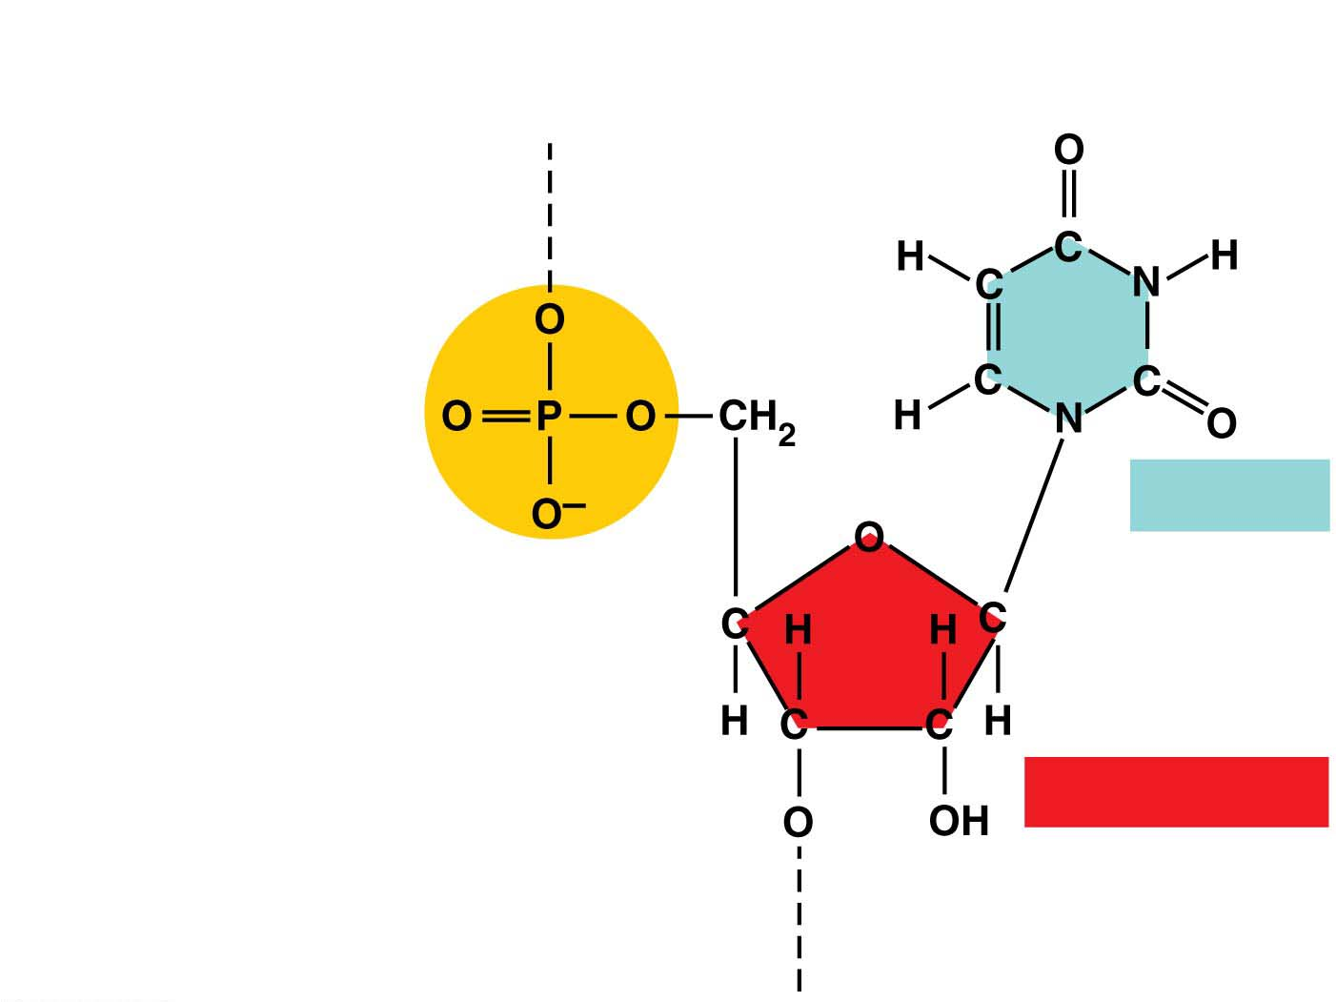
Figure 3.25
Nitrogenous base
(can be A, G, C, or U)
Connection to the next
nucleotide in the chain
Uracil (U)
Phosphate
group
Sugar (ribose)
Connection to the next
nucleotide in the chain
Notes:
Figure 3.25 An RNA nucleotide

